Slide 1

Attleboro Dyeworks Site Redevelopment Project
EPA Office of Brownfields and Land Revitalization
Regionally-Directed Technical Assistance
Eliza Johnston, Julia Borgida, Clay Lin – ICF
Mike Fox – SGA

Slide 2

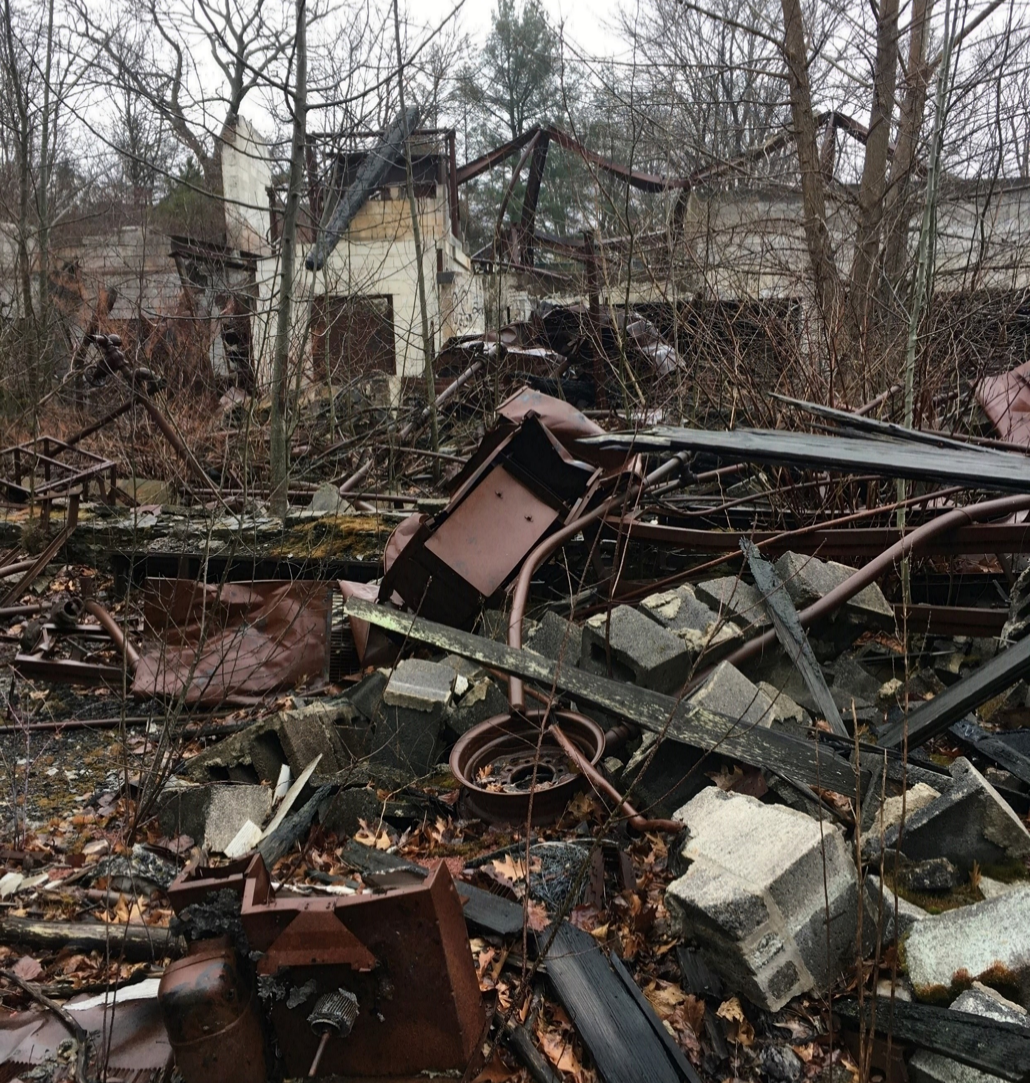

Introduction
Brownfields Technical Assistance
EPA HQ and Regions provide technical assistance to communities facing redevelopment challenges on brownfield sites
Support covers:
Market Analysis
Stakeholder Engagement
Site Reuse Planning

Slide 3
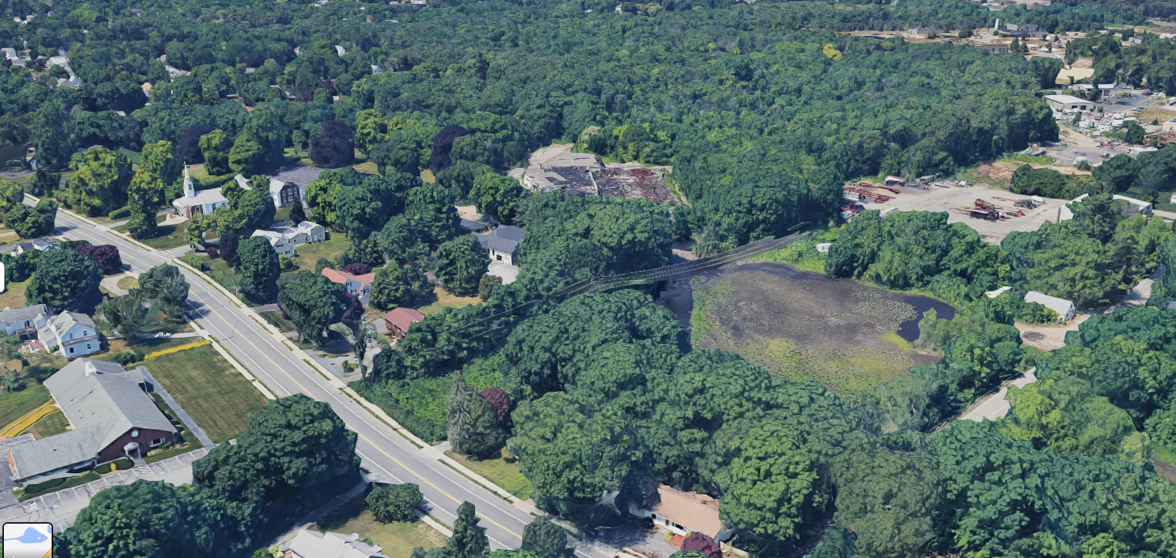
Project Background
The Town of Seekonk requested technical assistance from EPA R1 to conduct a site reuse feasibility at the Attleboro Dye Works site at 36 Maple Avenue, Seekonk, Massachusetts
The feasibility study builds from the reuse opportunities presented by the MassDevelopment TA, identifies specific end use, develops two site reuse scenario plans, investigates infrastructure improvements, prepares a site build-out yield table and level-of-magnitude costs, and design parameters and site framework.
ATTLEBORO STP
ORION INDUSTRIAL PARK
SITE
MAPLE AVE
DAM
MILL POND
CENTRAL AVE
POND STREET BRIDGE
ROUTE 152
3

Slide 4
Where We Are
March 2022
TA Request
Received TA Request from Region 1 and Town of Seekonk
April – August 2022
Scope Development
Iterated on the technical assistance project based on MassDev report findings
August - September 2022
Review Background Documents
Review various plans, past projects, and existing data for the site
Site Visit
October 2022
Participate in 1-day site visit with tour and listening session
November - December 2022
Site reuse feasibility
assessment
Based on feedback from the site visit and analysis, develop feasibility assessment & refine market analysis
January – February 2023
Project Wrap Up
Prepare draft and final deliverables

Slide 5
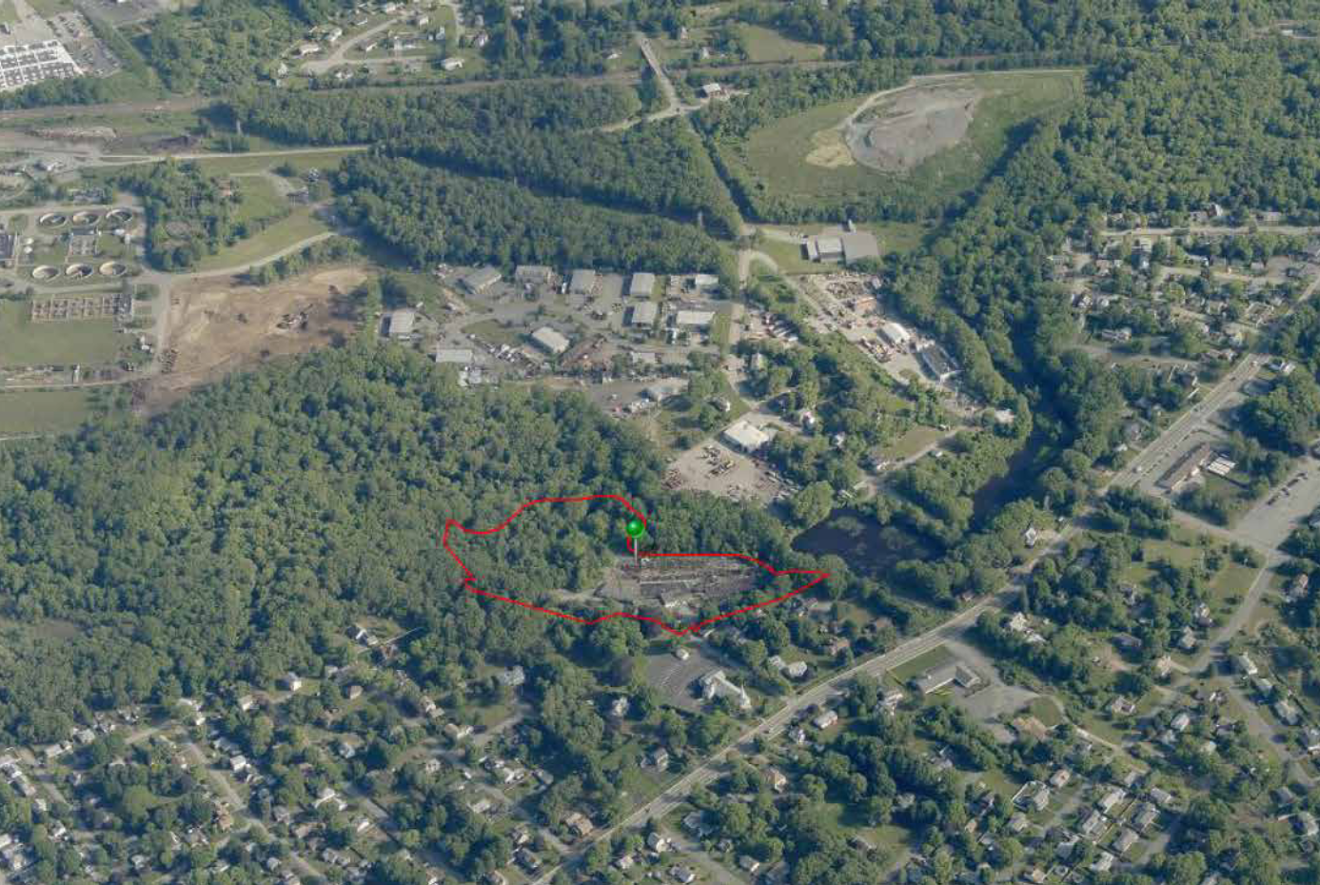
Site Context
MassDevelopment Report for Maple Avenue on the Ten Mile River in Seekonk, MA describes the site context as:
Easy access to Providence, Pawtucket, Boston, and surrounding metro areas
10-minutes by foot is Bakers Corner, which has convenience retail and restaurants
Ten Mile River Lofts: reuse development on the river with mixed use residential and small industrial
No public wastewater collection or treatment in the Town of Seekonk.
5
Notes:
Photo: The Maple Avenue site is located just off Central Avenue/Route 152 in Seekonk on the Ten Mile River.

Slide 6
Development Scenarios
Industrial Development
25,000 SF single story industrial building
Concerns with visibility from the highway, but proximity to I-95 and consistency with past uses and zoning is a benefit
Industrial sectors of interest include clean tech, wind energy start-ups, and medical device companies as well as landscaping and construction yards, fuel oil services, asphalt paving, building equipment, waste management and autobody operations.
MassDevelopment presented 3 concept plans -- all restore access to the riverfront and woodlands which were previously restricted due to dangers such as contamination and building wreckage
Residential Development
Mixed Use Development
Approximately 41 townhouses
Address the growth in nearby metro populations coupled with housing inventory declines since COVID
Residential development allows for public access to the dam and riverfront trails
Two story, approximately 36,000 SF
Possible uses include a brewery or other destination activities due to lack of visibility from the road for more traditional retail businesses
Residential loft apartments, with approximately 15 to 20 units on the upper floor / possibly some ground floor
6

Slide 7
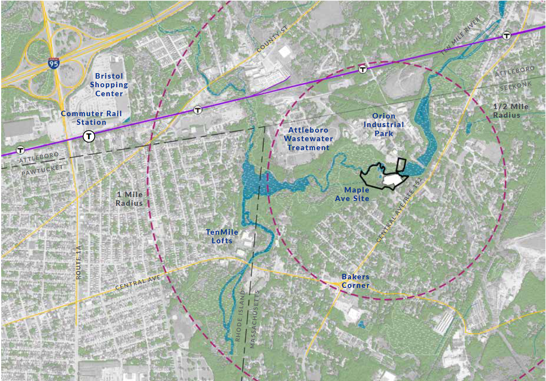
Community Concerns
MassDevelopment identified concerns with balancing public trail access with not attracting too much traffic to trails.
Community desire to close trails at nightfall and not provide too much public parking to keep traffic levels light.
7

Slide 8
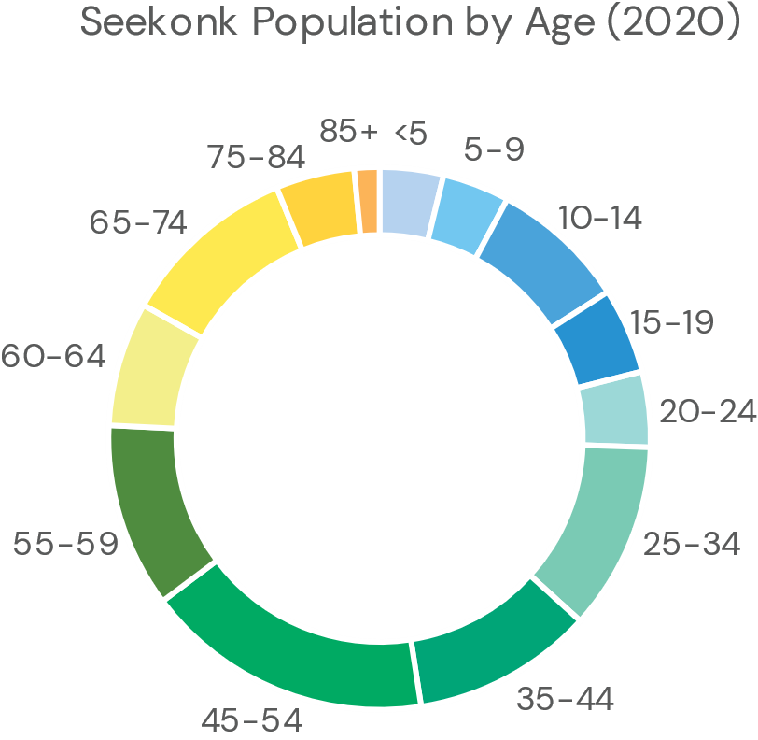
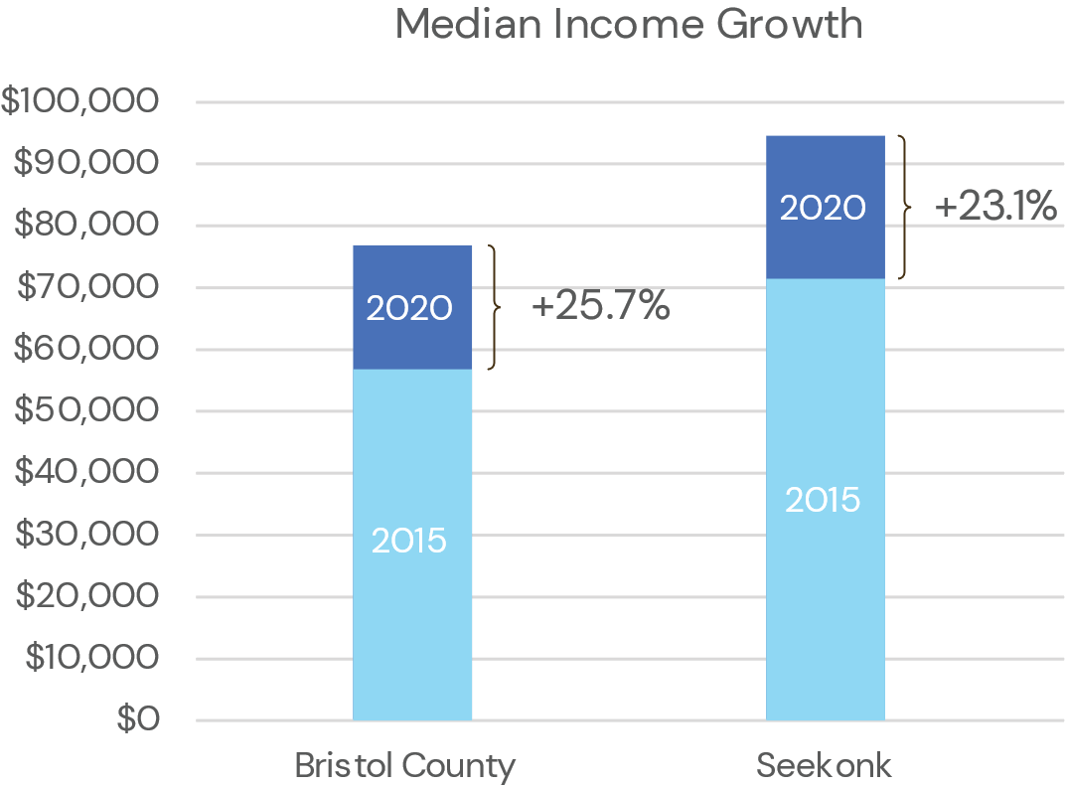
Population Trends
Analyzed Census Bureau Data for Seekonk and Bristol County
Overall, Seekonk is in a stronger position than Bristol County as a whole, with higher population growth and income but with an older median age.
8.6%
46.1
$94,611
Population Growth in Seekonk (2015 – 2020)
15,613 Seekonk Residents in 2020
1.9% Bristol County population growth to 563,301 residents.
2020 Median Age in Seekonk
Aging slightly from 2015
41.0 median age in Bristol County, with similar aging trends to the town.
2020 median household income in Seekonk
23.1% increase from 2015
$71,450 median household income on the County level.W

Slide 9
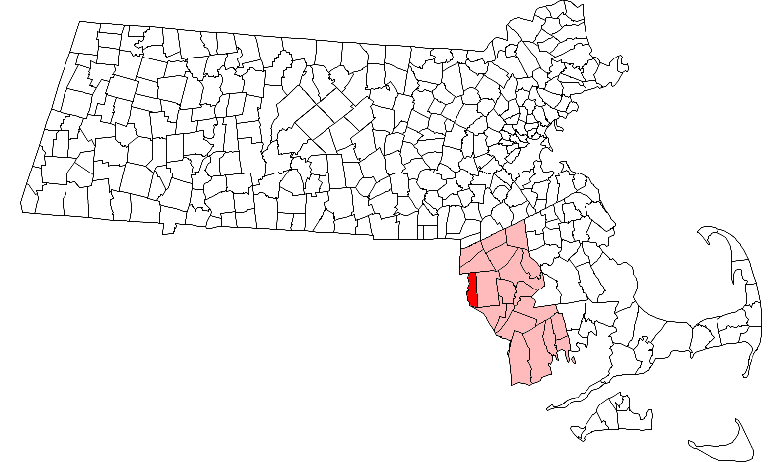
Labor Force and Industry Trends
3.0%
Under 25 minutes
Unemployment Rate in Seekonk
Decrease by 57% from 2015 – 2020
Lower unemployment rate in Seekonk than surrounding Bristol County
Average commute time (similar to county)
Decrease in workers driving alone, walking to work, and commuting by other means
Increase in residents working from home (11.4% total)
Overall healthy unemployment levels, with changes in commuting patterns from 2015 – 2020
49.2%
28.1%
Population working in management, business, and science and arts occupations
Increased by 27.7% from 2015 – 2020
Followed by sales and office employment (20.7%)
Employed population working in educational services, and health care and social assistance
Followed by manufacturing (28.1% in Seekonk) and retail trade (12.4%) in the town and county
9
Notes:
Analyzed Census Bureau Data for Seekonk and Bristol County

Slide 10
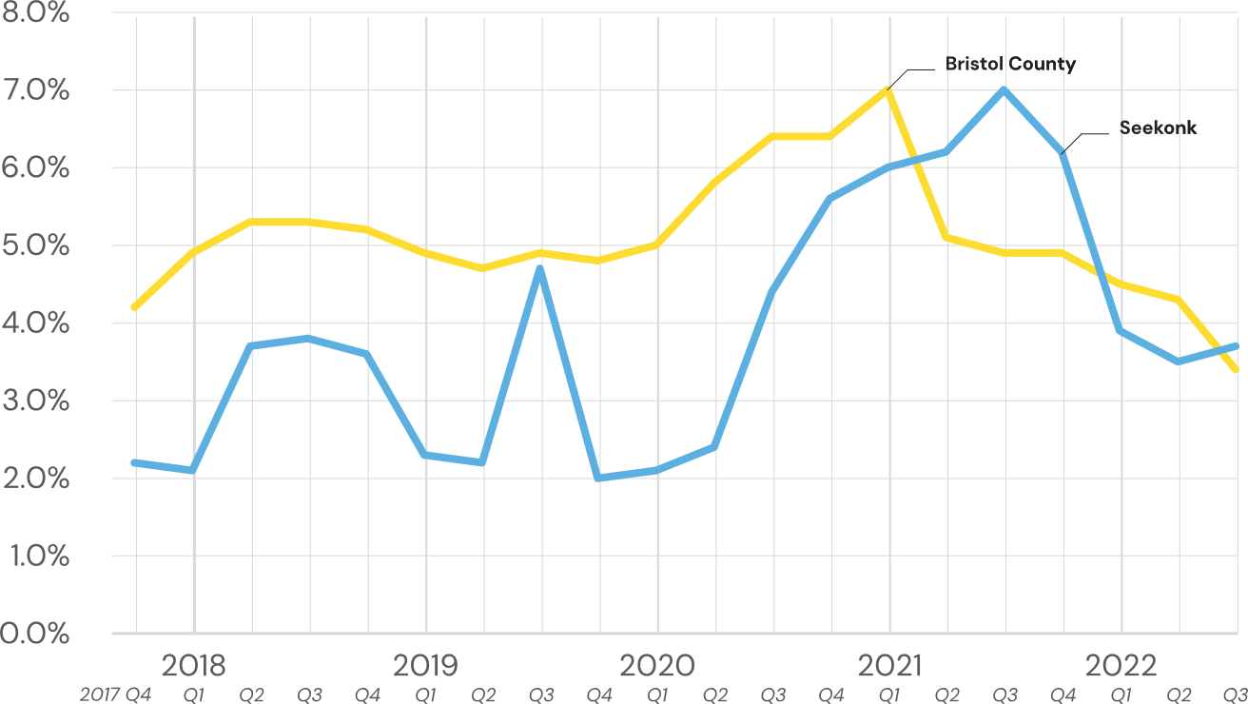
Retail Real Estate Trends
Retail Vacancy Rate
Overall, retail vacancy jumped during the COVID pandemic, but has since decreased in the aftermath
Tight retail real estate market, with vacancy rates lower than ideal
+6,000 SF
Retail New Construction in Seekonk (Q3 2022)
Total retail space has stayed relatively consistent for the past five years, with two new constructions and a demolition
460,439 SF of new retail space in Bristol County (inclusive of Seekonk), suggesting more activity at the County level

Slide 11
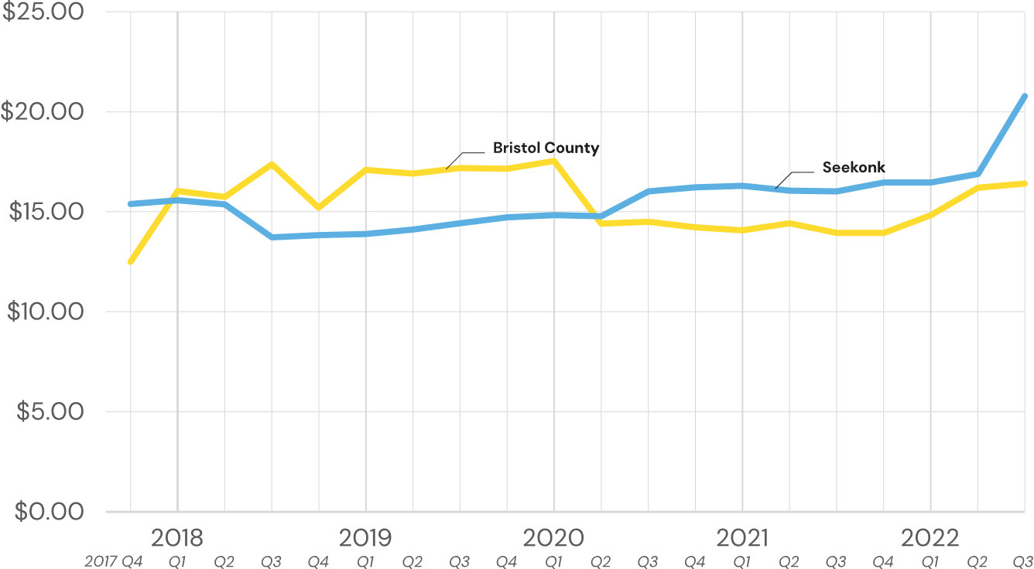
Retail Real Estate Rent
Retail (All Services) Rent per SF
$20.78/SF
Average asking rent per SF (Q3 2022)
Rental costs reached a low in 2016 and have since fluctuated but have increased overall

Slide 12
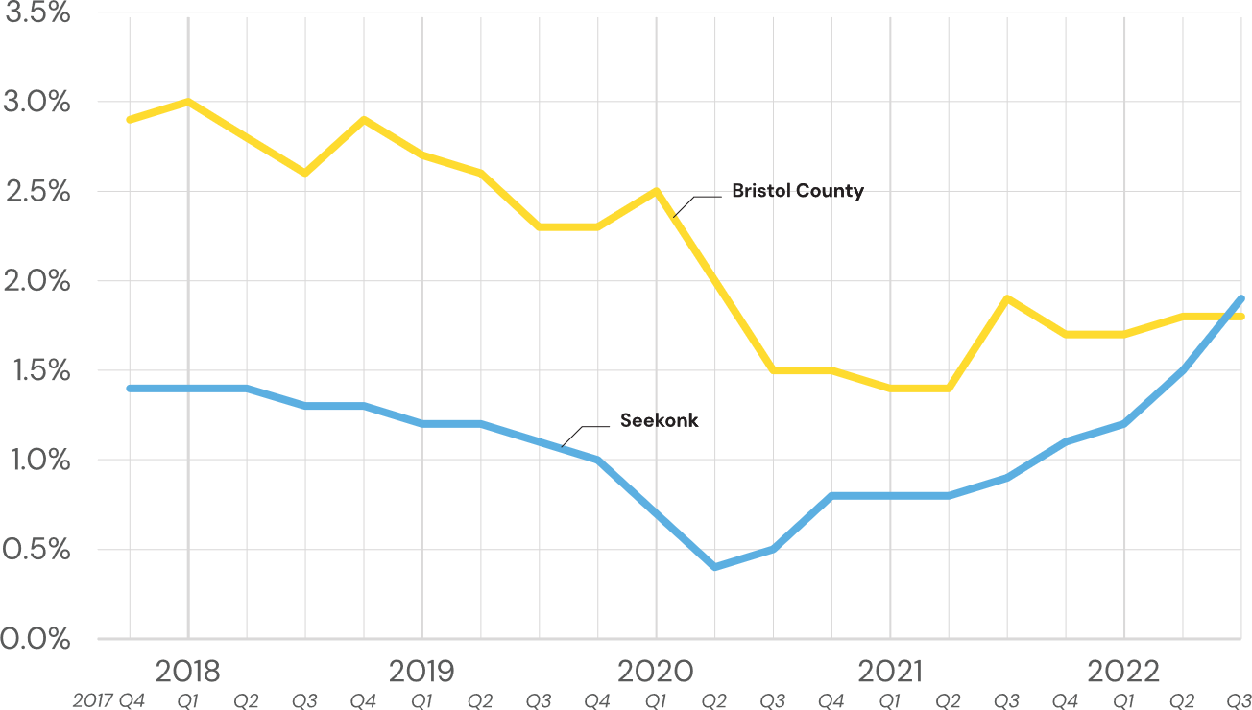
Multifamily Real Estate Trends
Multi-Family Vacancy Rate
1,113
Multi-family Rental Units in Seekonk (Q3 2022)
The number of rental units has not increased since 2016
Bristol County has 32,480 units of multi-family housing (inclusive of Seekonk units) – Seekonk makes up a higher per capita multi-family inventory than the county
Vacancy rates are also lower in Seekonk compared to the county, but has risen since the pandemic
Notes:
Seems indicative that larger families are moving away from Seekonk since the pandemic and moving into surrounding areas.

Slide 13
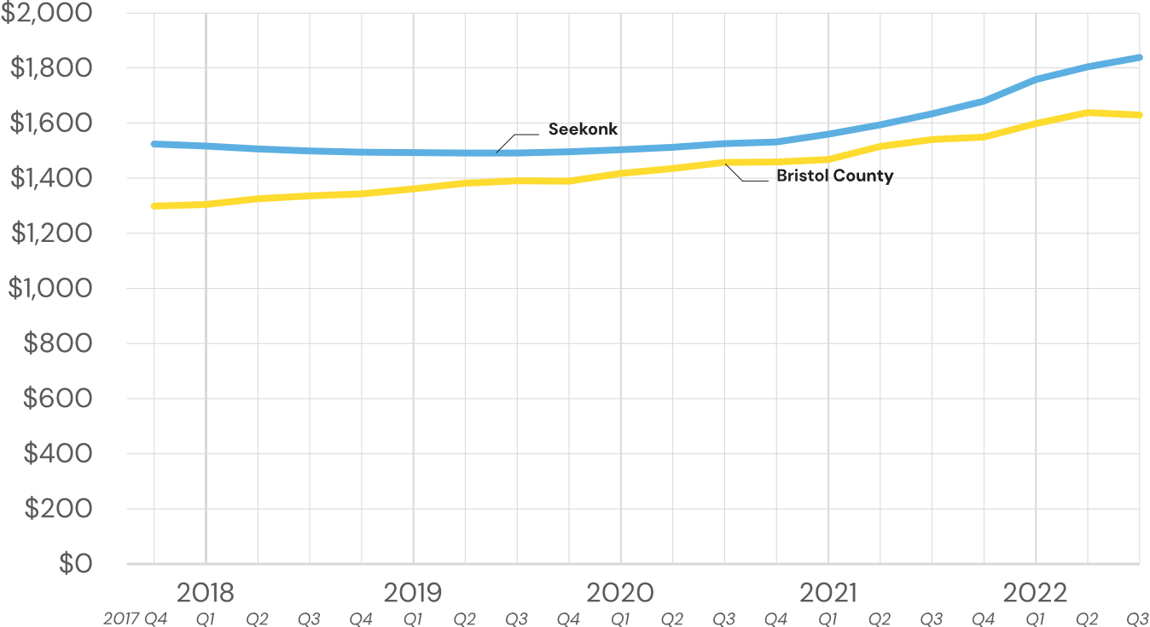
Multifamily Real Estate Rents
Multi-Family Asking Rent per Unit
$1,845
Average asking rent per unit in Seekonk (Q3 2022)
Rental costs are higher 13% higher in Seekonk than in Bristol County ($1,635/unit)
Unit sizes are also on average larger in Seekonk than in Bristol County (1,256 SF vs 922 SF) – per SF costs are lower in Seekonk in comparison

Slide 14
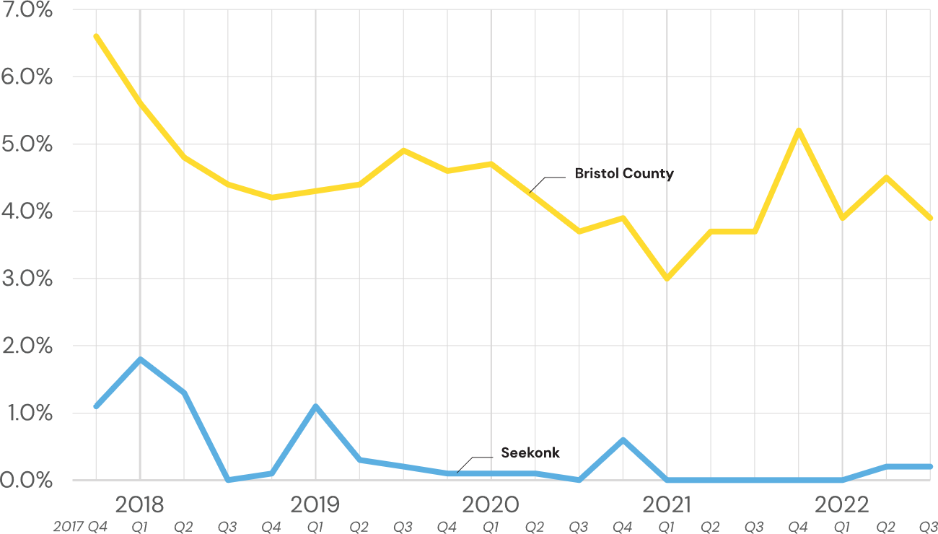
Industrial Real Estate Trends
Industrial Vacancy Rate
1.2 mil SF
Industrial inventory in Seekonk (Q3 2022)
Much lower vacancy rate in Seekonk compared to Bristol County.
Bristol has 59.6 million SF in industrial real estate (inclusive of Seekonk) – Seekonk makes up only 2% of available inventory

Slide 15
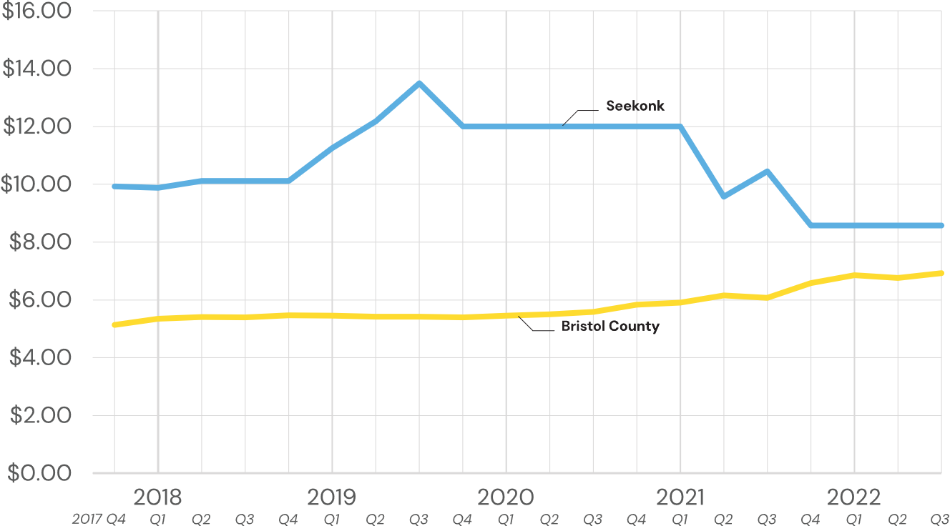
Industrial Real Estate Trends
Industrial Rent per SF
+10,000
Industrial SF under construction (Q3 2022)
New construction finished 4th quarter 2020 – uptick of 250,000 SF in 2018
1.5 million SF under construction in Bristol County, with consistent inventory fluctuating around 60 million SF
Notes:
A lower rental rate with limited inventory suggest industrial hub in the county is elsewhere?

Slide 16
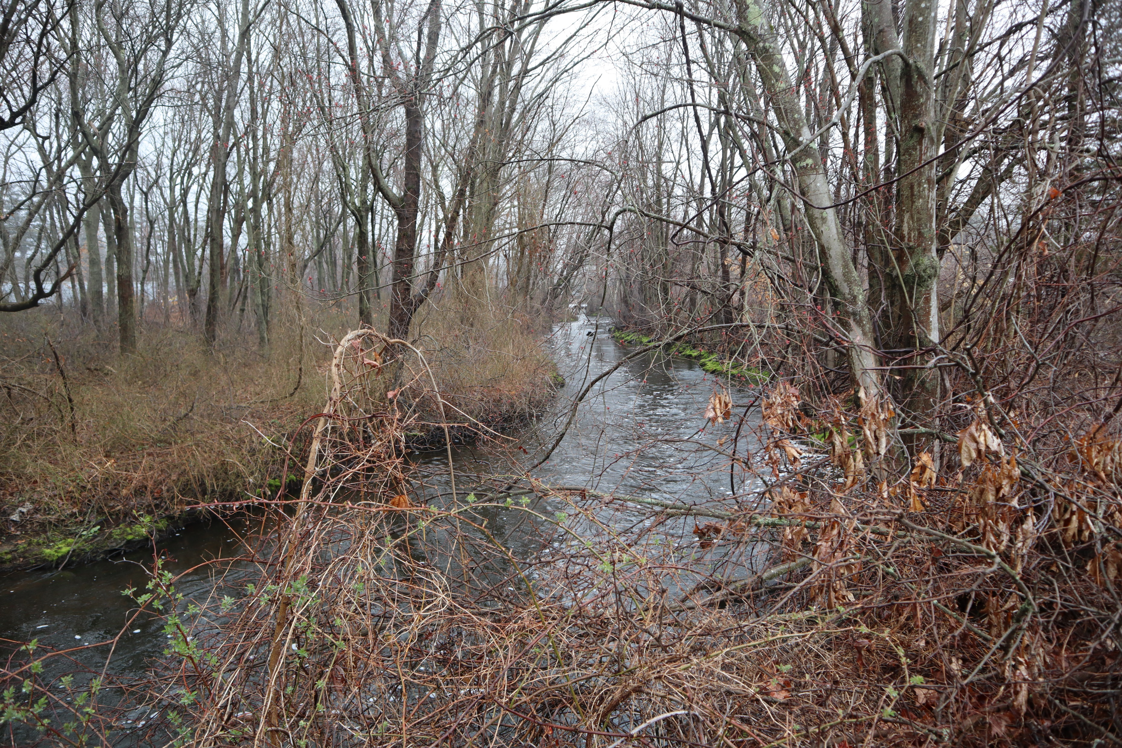
Summary of Key Trends
Demographic
Housing
Larger population growth and higher median income in Seekonk than at the county level
Slightly aging population, with an older median age than the county level
Limited inventory and strong demand for housing in Seekonk and in Bristol County
Suburban lifestyle has the potential to draw residents who are able to work remotely
Labor Market
Retail
Change in commuting patterns following the COVID-pandemic, with more residents working from home
Largest employment sector is healthcare, education, and social services followed by manufacturing
Tight retail real estate market, with low vacancy and little new development to meet the demand
More new construction occurring at the county level

Slide 17
Next Steps and Schedule
Incorporate feedback from the site visit and prepare deliverables
Activity | Duration/Due Date
Task 1 – Scoping and Planning Meetings | April-August 2022
Task 2 – Document/Data Request Review | September 2022
Task 3 – Site Visit | October 2022
Task 4 – Market Analysis Refinement | October - December 2022
Task 5 – Site Reuse Feasibility Assessment | October 2022 – February 2023
Draft Study | January 2022
Final Study | February 2022

