Slide 1
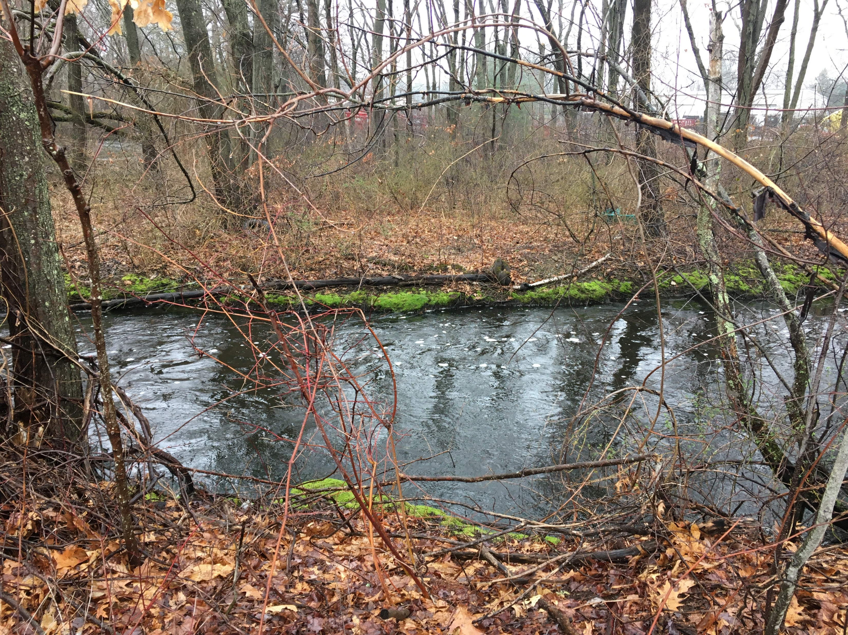
Attleboro Dyeworks in Seekonk
SITE ANALYSIS / REDEVELOPMENT OPPORTUNITIES
June 8, 2022
Joint Board of Selectmen & Planning Board Meeting
Madden Planning Group | Goode Landscape Studio

Slide 2
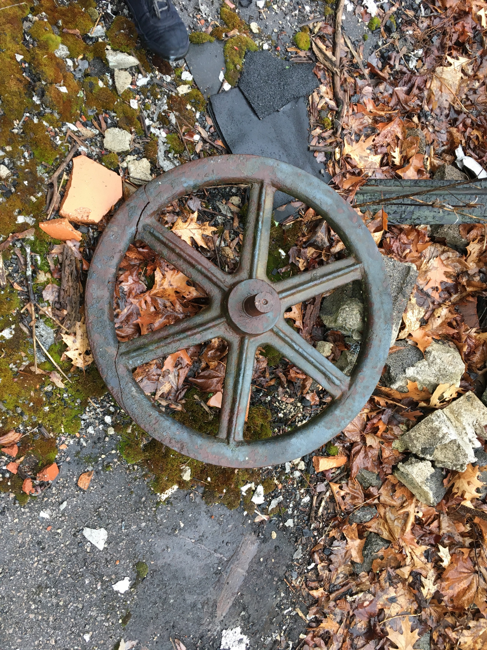
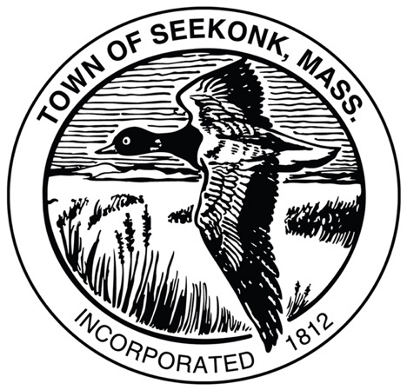



Agenda
Project History and Goals
Site and Regulatory Analysis
Development Potential
Implementation Process
FY22 Real Estate Services Technical Assistance

Slide 3

Project History
Planning
MassDev RE Tech Assistance Grant
Dam Removal Study
Pond Street Bridge Study
Sewage Treatment Options
Plan for Development RFP
Remediation
Assessment reports; remediation of Settling Pond #3 completed; begin remediation of #1 and #2
Acquisition
Town acquires property through tax taking
Abandonment
Devasting fire, building collapses; MA DEP outreach to owner for access
Development Potential
Blight
Control
Clean Up
Fire
Request for EPA Assistance
Site access for initial assessment & clean up
Town Acquisition
Ph. I - III Reports
MassDev Grant
2012 - 2018 | 2019 | 2020 | 2021 | 2022 | 2023
Pandemic
https://eeaonline.eea.state.ma.us/EEA/fileviewer/Rtn.aspx?rtn=4-0021606
Notes:
Fire 2012 (roof collapse in 2010)
Emergency remediation 2016 – containerized drums
Awarded both EPA and state grants in 2017 and began work in 2018
ROC Realty tax foreclosure

Slide 4
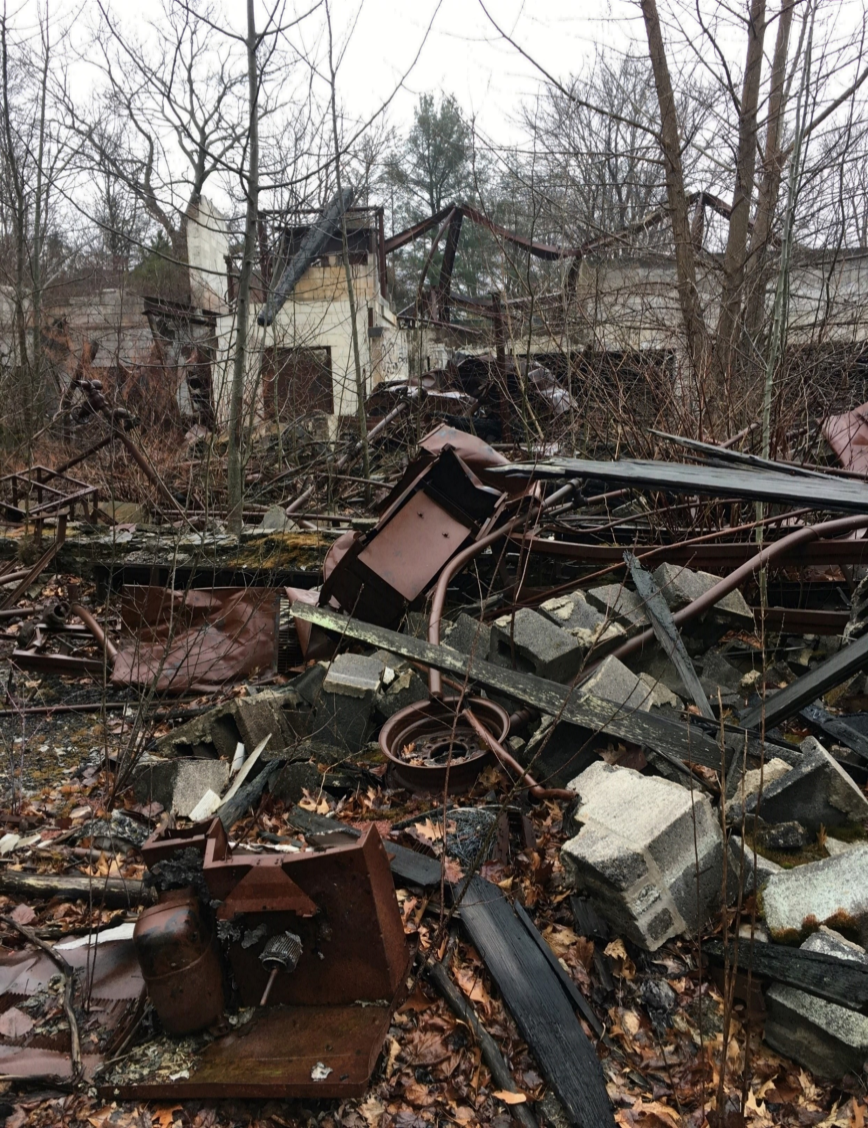
Project Goals
Redevelop blighted and surplus public property: support ongoing efforts to remediate site and remove building debris
Return the site to the active tax rolls: work toward disposition through a developers’ Request for Proposals (RFP)
Advance smart growth: design compact development with complementary open space and a focus on form
Identify a range of redevelopment scenarios: cast a wide net of possible uses to attract developer interest on a challenging site
The current site is inaccessible due to fire wreckage and contaminated materials.
(Seekonk Master Plan, Economic Development, 2019)

Slide 5
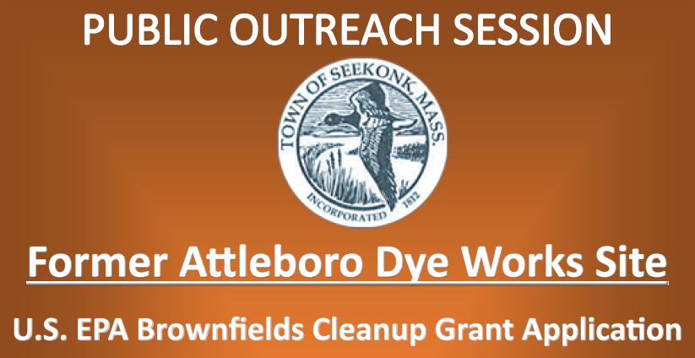
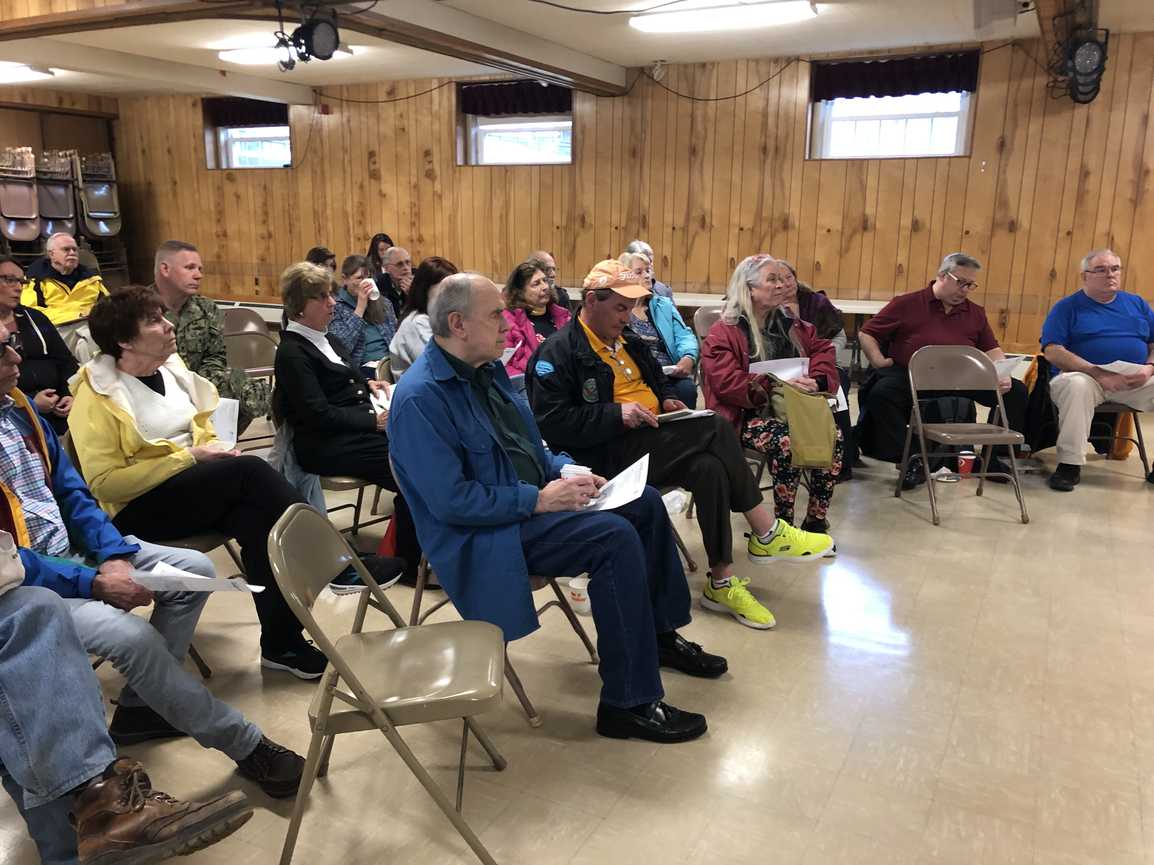
Community Engagement
Align with ongoing Town Master Plan
Outreach to residents and businesses near site
Meet with Town leaders: Board of Selectmen and Planning Board
Meeting flyer for earlier session on October 19, 2020
Alignment with Current & Ongoing Town Plans
Promote Town prosperity and fiscal health through economic development (Seekonk Master Plan, ED, 2019)
Encourage sustainable, smart growth patterns (Seekonk Master Plan, Land Use, 2012)
Maintain the viability of industrial areas (Seekonk Master Plan, Land Use, 2012)
Promote more multifamily housing (Seekonk Housing Production Plan, 2010)
Community meeting on preliminary analysis, April 6, 2022

Slide 6
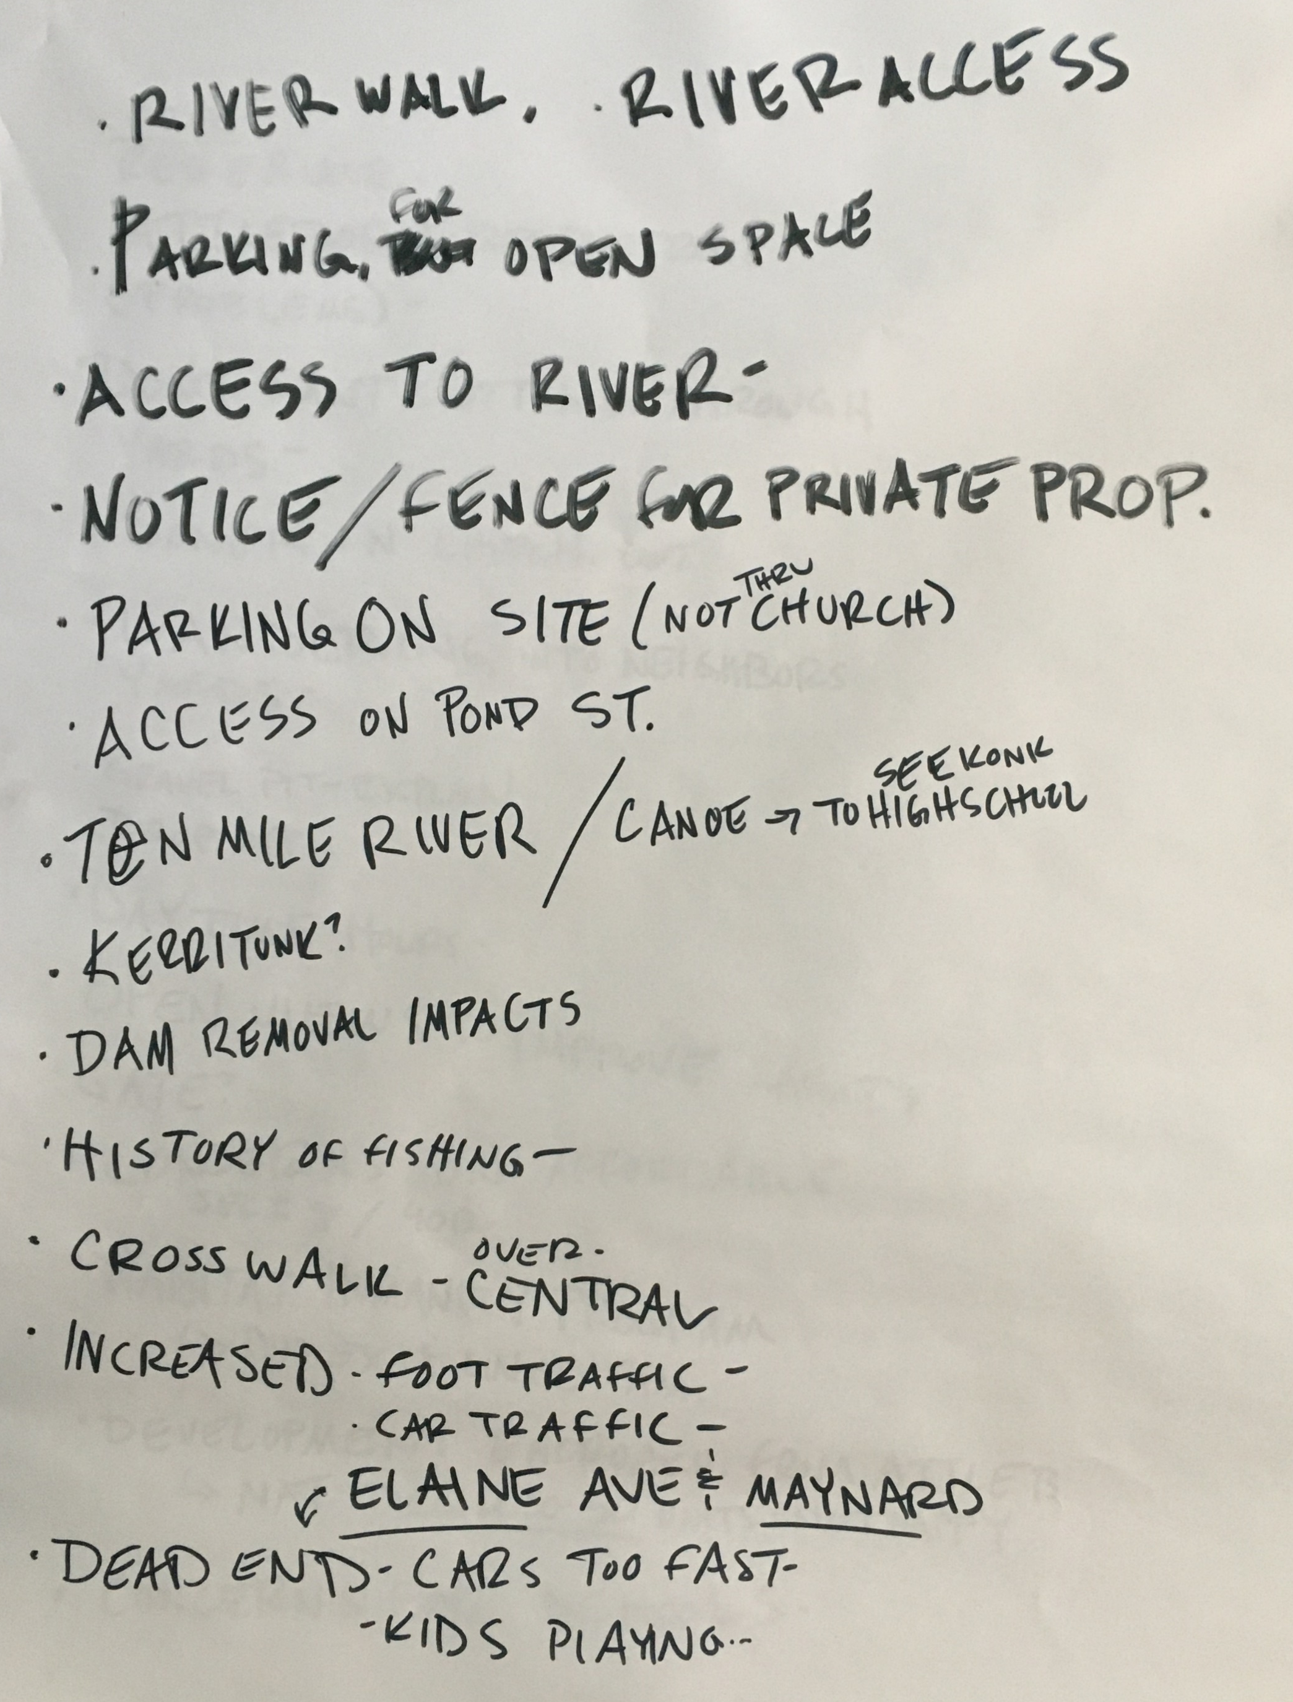
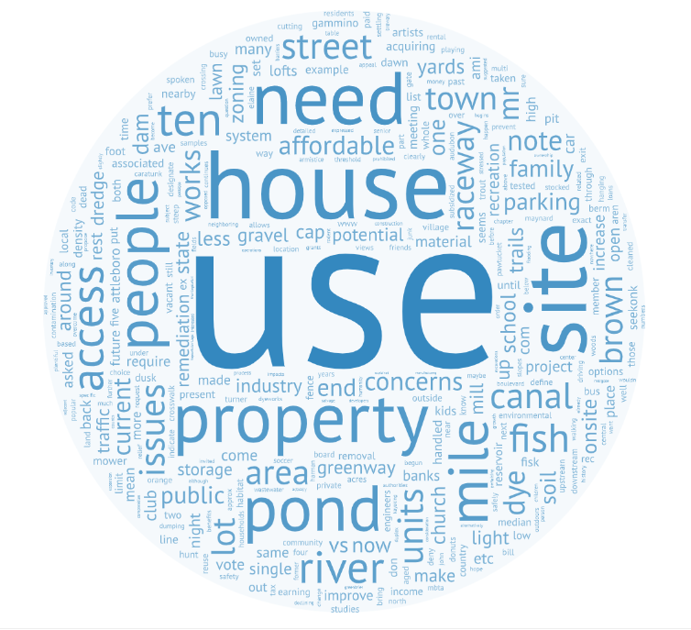
Community engagement
Community Forum: April 6, 2022
Remediation: questions and updates about status
Site access: discussion about visitor use, access, and parking as both an opportunity and a concern; increased safety with more use and open views
Recreational use: fishing if stocked; kayaking; dam removal could help fish; concerns about flooding upstream
Trail systems: examples of Caratunk and Ten Mile River Greenway
Reuse options: questions about wastewater; worries about housing, but lofts like Hope Artiste Village/Village Lofts seemed okay; recreation centers would bring too much traffic; industry maybe less impact; brewery suggestion
wordart.com

Slide 7
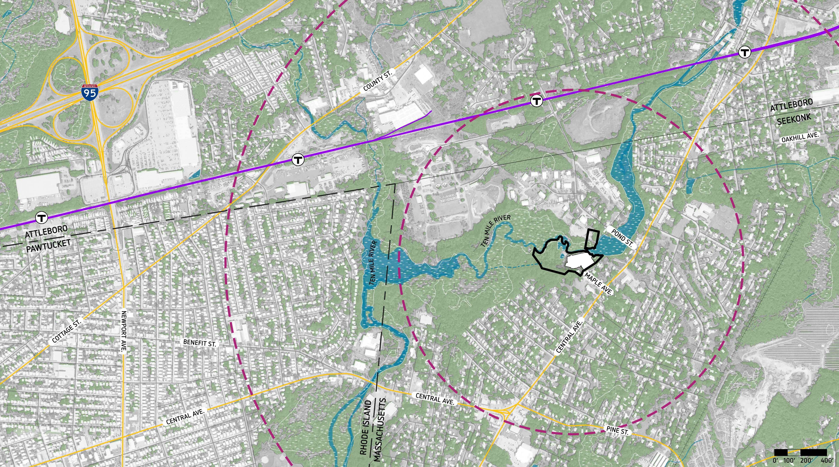
Site Analysis: Regional context
Bristol Place Shopping Center
Attleboro Sewage Treatment
Orion Industrial Park
Commuter Rail Station
T
1 mile
radius
½ mile radius
Pinecrest
Solar Farm
Baker’s Corner
On Ten Mile River, approximately 7 miles upstream from confluence with Seekonk River
10-minute walk from Baker’s Corner
5-minute drive to South Attleboro Rail Station, Bristol Place Shopping Center, and I-95

Slide 8
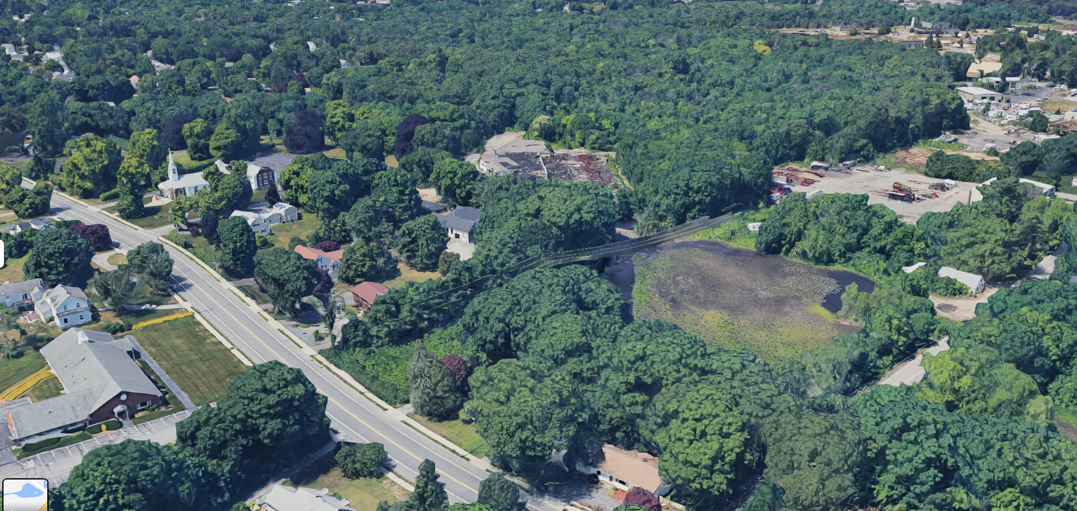
Site Analysis: CONTEXT AND Coordination
ATTLEBORO STP
ORION INDUSTRIAL PARK
SITE
MAPLE AVE
DAM
SITE
CENTRAL AVE
NE POWER CO. EASEMENT
MILL POND
POND STREET BRIDGE
ROUTE 152
View looking southwest
Infrastructure Notes:
Access from Maple Avenue; not from Pond Street
Sewage treatment options: septic system, package plant, Attleboro Sewage Treatment Plant connection
Utilities: Gas, electric, and water
Ongoing Studies
MassDevelopment Real Estate Technical Assistance (Madden Planning/Goode Landscape Studio)
Pond Street Bridge (GPI Engineering)
Ten Mile River Dam (GPI Engineering)
Site Remediation (ES&M)
Wastewater Options (ES&M)

Slide 9
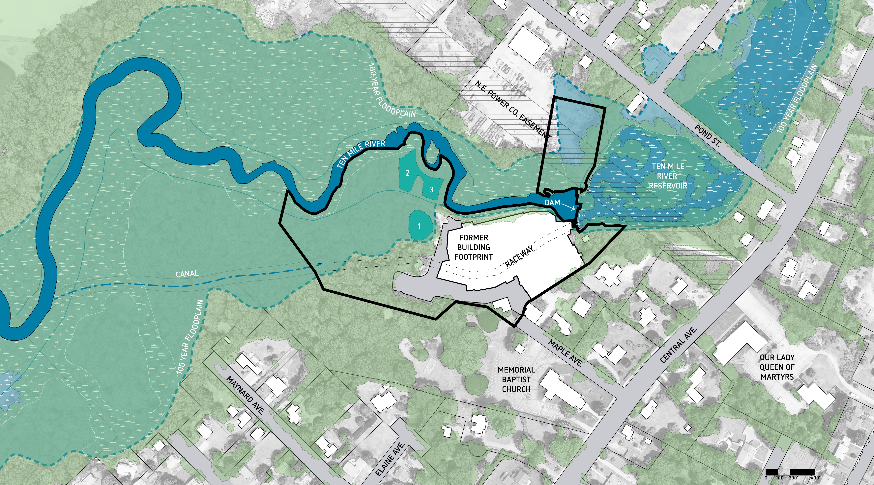
Site Analysis: Neighborhood context
POND ST INDUSTRIAL AREA
2
3
1
Site area: ~8.2 acres (three parcels)
Existing impervious area: ~2.7 acres of pavement and building footprints
Settling Pond #3 remediated; Ponds #1 and 2 remediation grant has been awarded
Land subject to flooding, bordering vegetated wetlands, land underwater, and riverfront areas
Ransom Consulting, October 2018, Existing Conditions Plan (parcel areas)

Slide 10
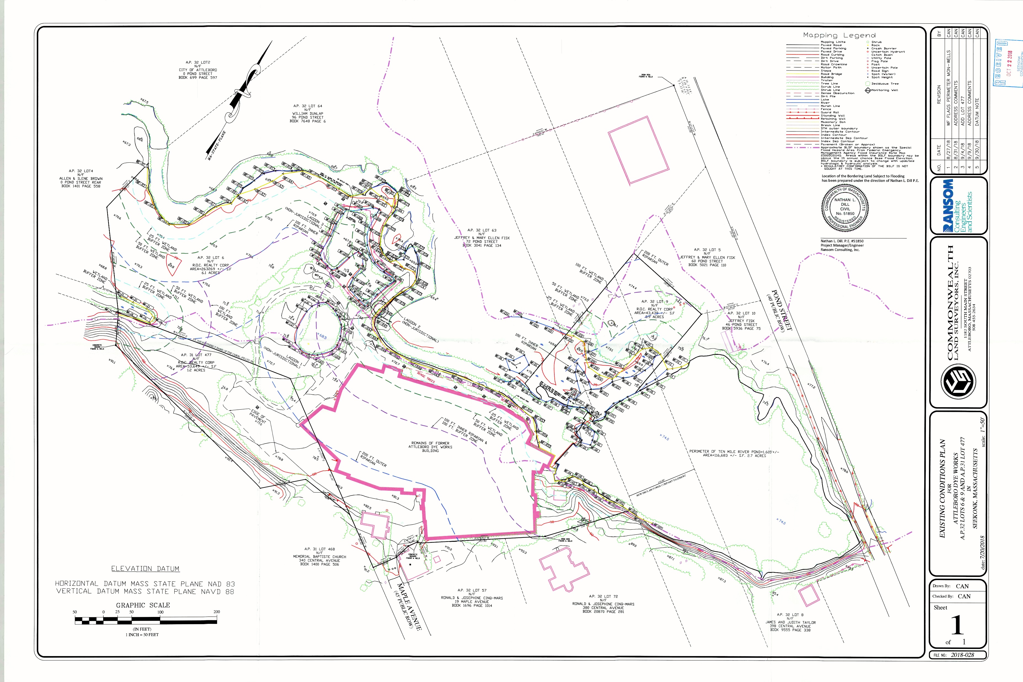
Ownership: Property Survey
Lot # | Survey
Lot 6 | 6.1 ac
Lot 477 | 1.2 ac
Lot 9 | 0.9 ac
TOTAL | 8.2 ac
Lot 6
Lot 9
Lot 477
Previously developed impervious area (2.7 ac)
Previous building footprint
Developable portion of the site is ~33% of total
Note: Survey acreage varies slightly from assessor’s records
Ransom Consulting, October 2018, Existing Conditions Plan (parcel areas)

Slide 11
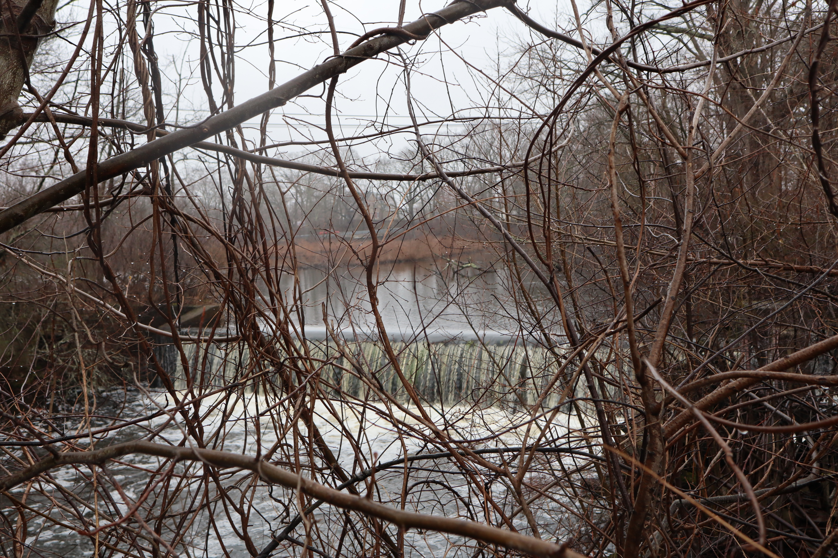
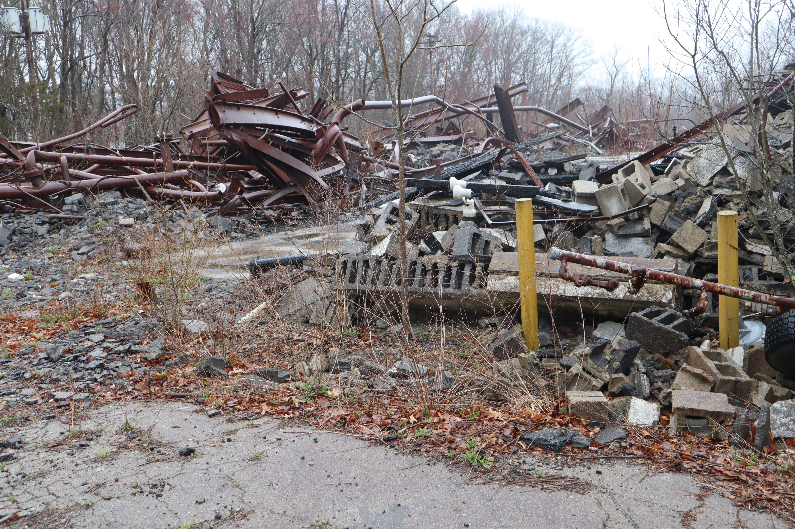
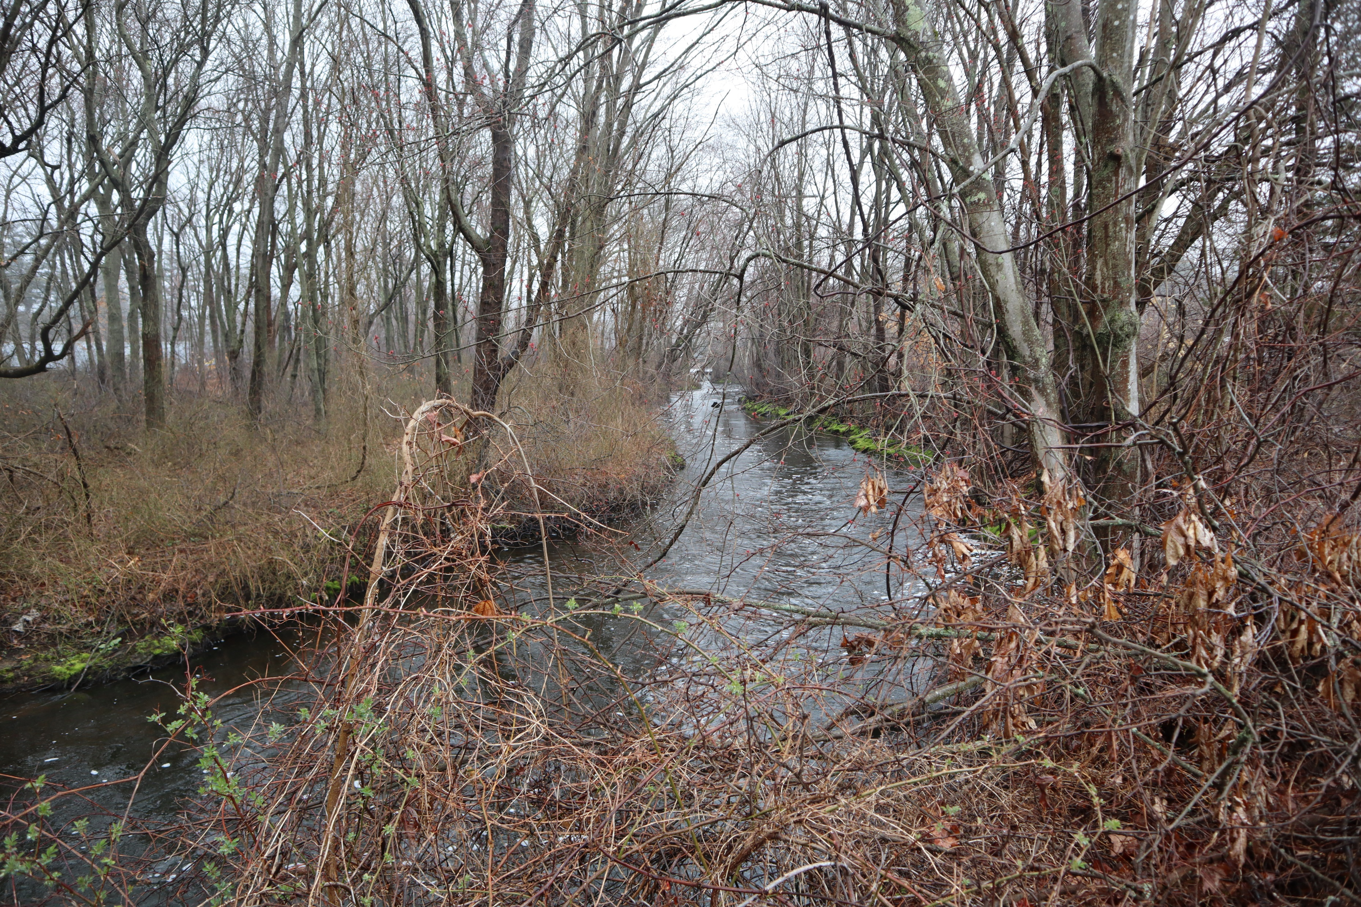
Ownership: Water Rights
1981 deed includes “all right, title, and interest in and to all dams, flowage rights, flowed land, trenches, raceways, canals, waterpower, and water rights, littoral or riparian rights and the Mill Ponds… appurtenant to…”
Dam and Mill Pond
Building wreckage from 2012 fire
Ten Mile River

Slide 12
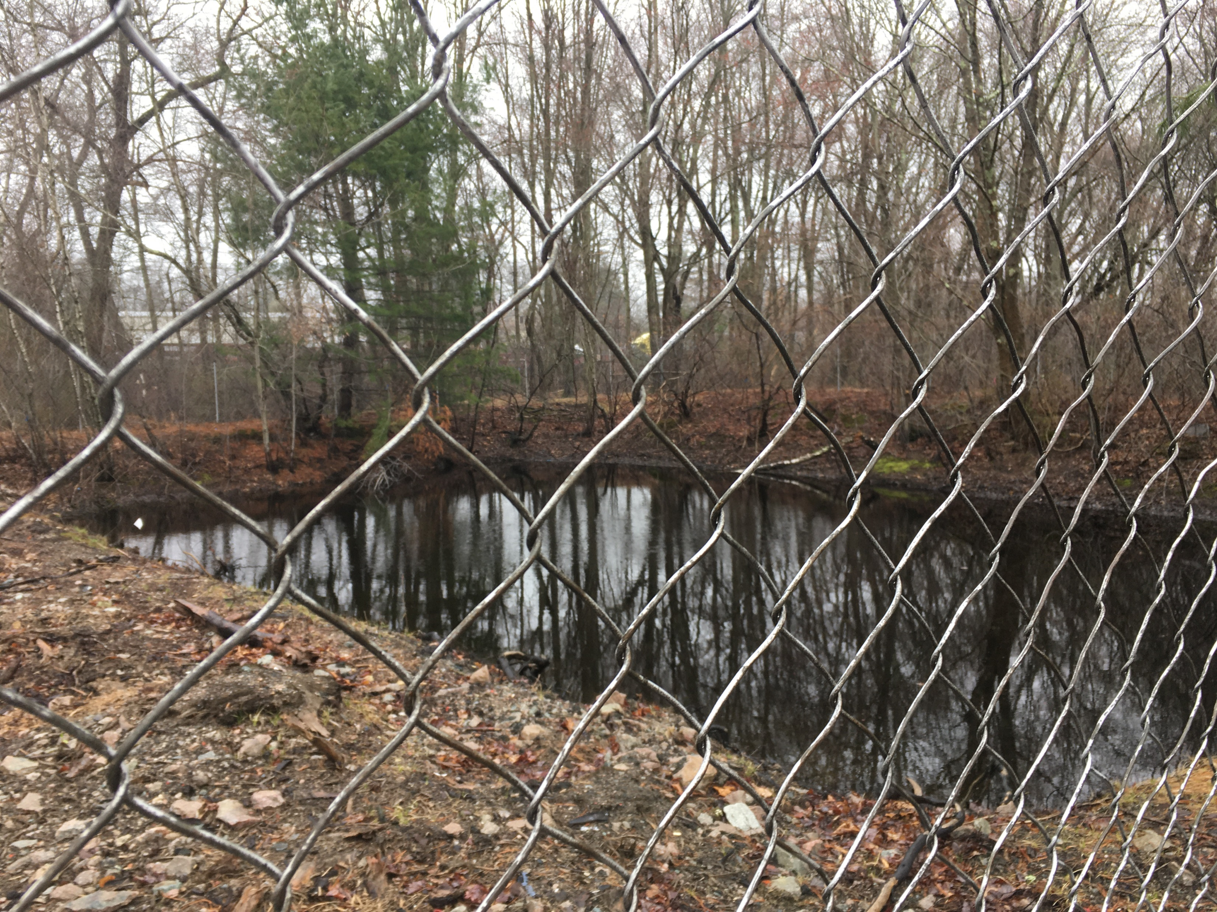
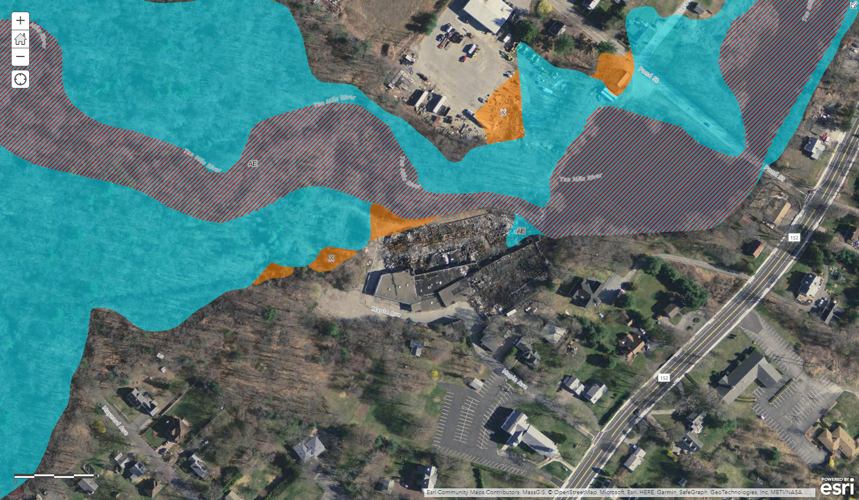
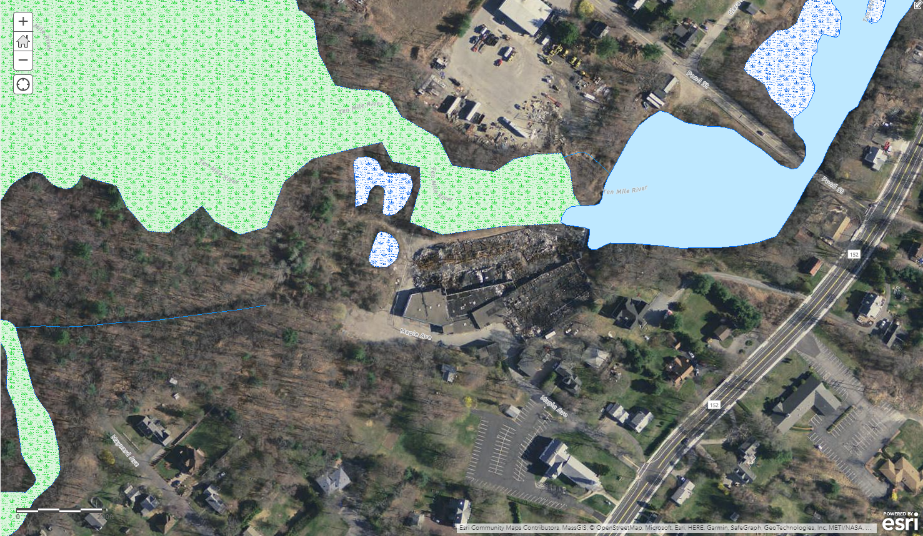
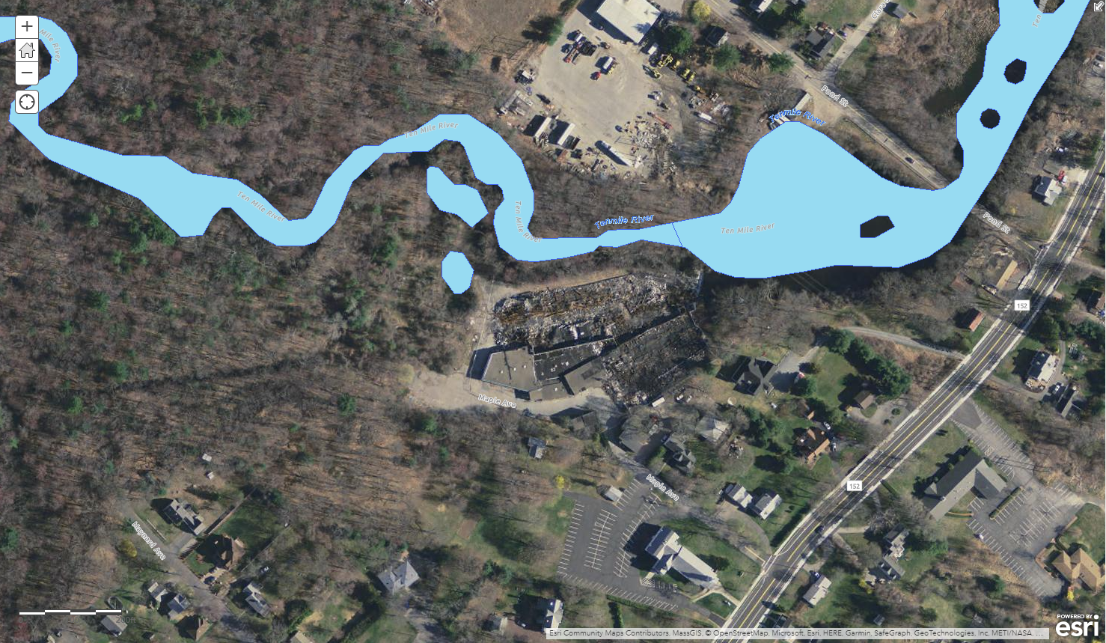
Regulatory Analysis: Wetlands
Riverfront Area
Redevelopment limited to previously developed area
Land Subject to Flooding
Any development would need to provide compensatory storage
On this site, flood zones set aside for open space
Bordering Vegetated Wetlands
0-25 feet natural vegetation/no touch
25-50 feet no structures
50-100 feet permitting required
New development needs to manage stormwater
Settling Pond #3 has been remediated
Site features river, wetlands, and flooding
Mass 310 CMR Wetlands Regulations; Seekonk Conservation Commission

Slide 13
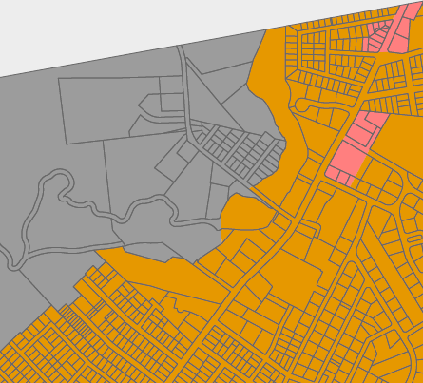
Regulatory Analysis: ZoninG
Existing Zoning: Industry
Manufacturing, assembly, etc. by right
8 residential units over ground floor commercial with special permit
Zoning Considerations
Multi-family Development Overlay: 4.3 units/acre, with minimum 40 acres
R-1: 3 units/acre, no multi-family
LCBD: 4.3 units/acre, multi-family
Chapter 40B
State threshold 10% subsidized housing
Town at 1.7% subsidized housing (87 affordable units)
Allows multifamily housing with 25% of units at 80% AMI ($67,300 for family of four)
Industry
Local Business
Industry
R-1
Existing Zoning
Reference: MA Housing Choice Bill
MBTA Adjacent Community
Establishes density at 15 units/acre
Multifamily by right within a contiguous land area of 50 acres
Affects eligibility for State funding
Town of Seekonk Zoning Ordinance; Chapter 40B, MA Housing Choice Bill
Notes:
[Median HH income at site $96k]

Slide 14
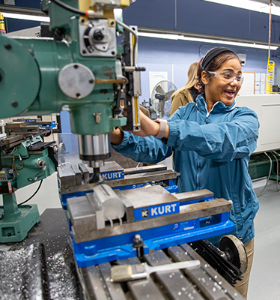
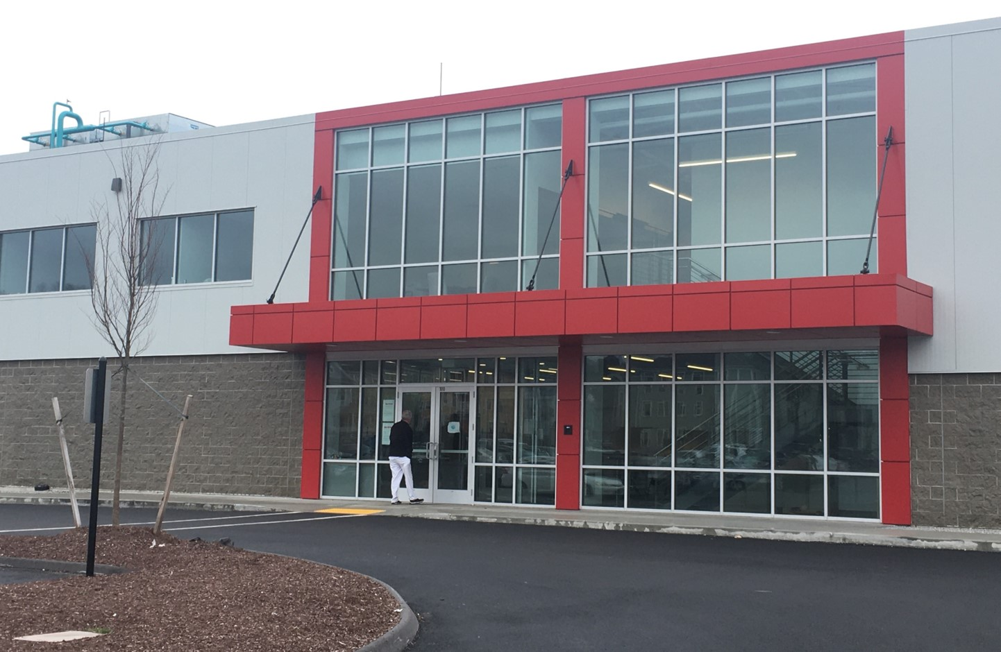
Development Potential: Industrial/Flex Space
Local industry clusters: electrical equipment, fabricated and primary metal manufacturing
Emerging industries: clean tech, wind energy, medical devices
Anchor institutions: Bristol CC, Providence universities, UMass Dartmouth, Center for Innovation and Entrepreneurship
Fabricated and primary metal manufacturing in Southeast Massachusetts
Sewage treatment options will affect the type of industry possible.
Industrial facilities in Worcester, MA (TableTalk Pies)
https://cam.masstech.org/; https://www.samcnetwork.org/;

Slide 15
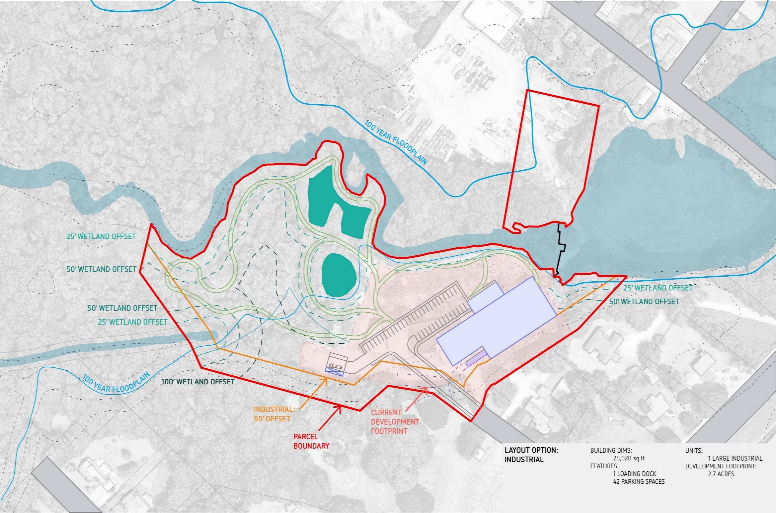
Concept Plan: INDUSTRIAL Scenario
Floor area: 25,000 sf
Building height: 1 story
Parking: 42 spaces, 1 loading dock
Development footprint: 2.7 acres
FAR = 0.07 across site; 0.2 on developable portion; developable portion = 33% of total site

Slide 16
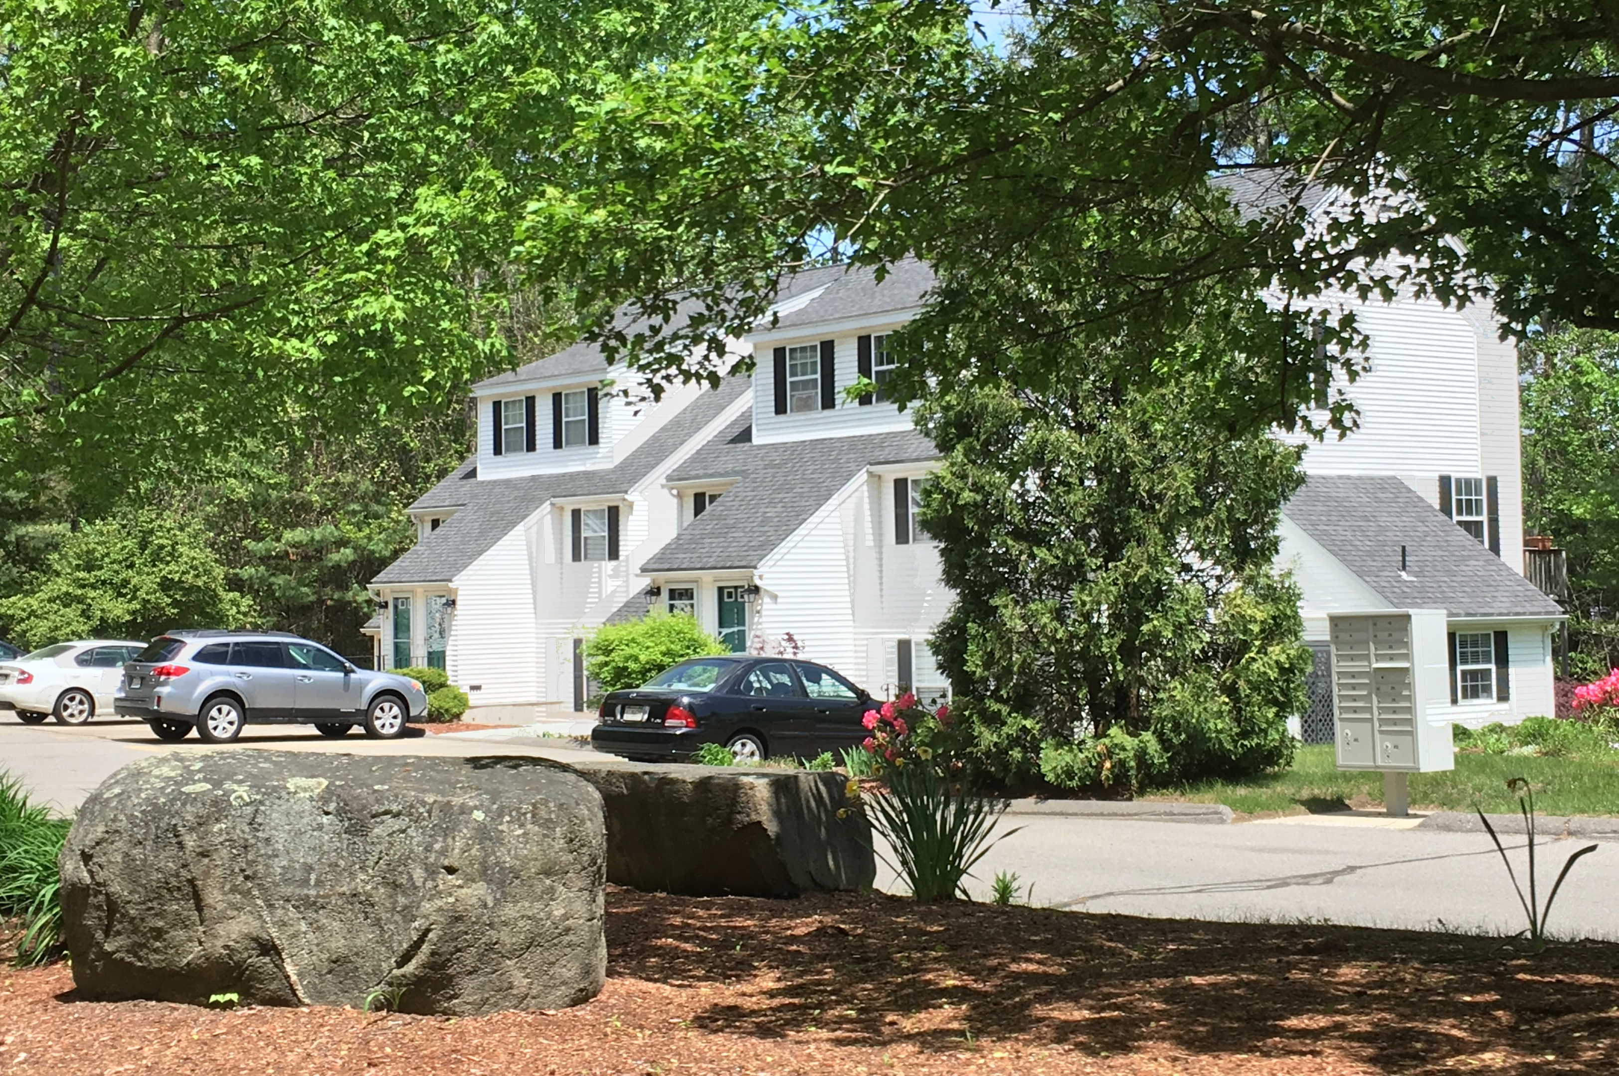
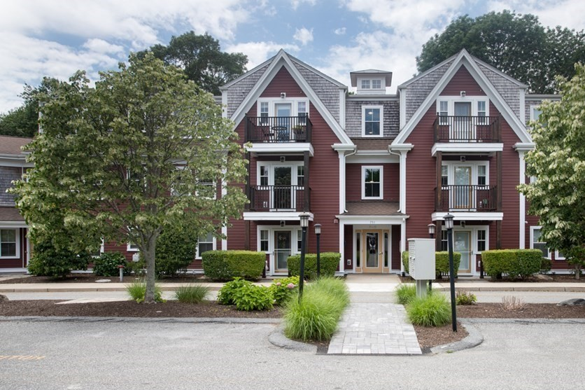
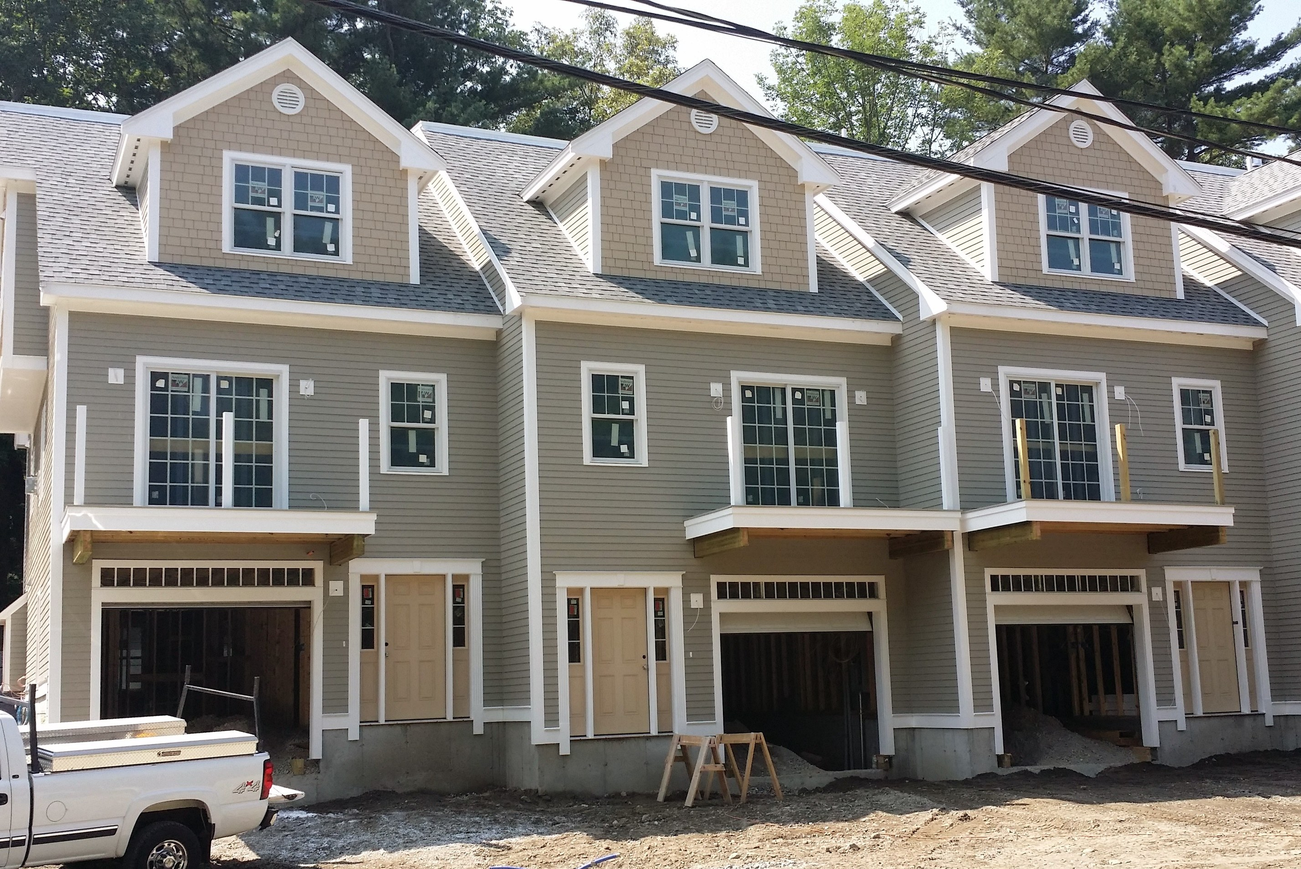
Development Potential: Residential
Housing demand in the region strong with limited inventory and ongoing demand
State policies, such as Housing Choice, support housing production
Townhouses or loft units likely given relatively small site
Liberty Commons, Leominster, MA
751 Metacom Ave, Bristol, RI
Ipswich River Place Condos, North Reading, MA
Sun Chronicle, April 2, 2022
Notes:
https://www.thesunchronicle.com/news/local_news/people-want-to-be-in-homes-attleboro-area-housing-market-still-hot-despite-high-prices/article_7be45e9b-9fe0-54a5-8576-2dd524e6ba66.html

Slide 17
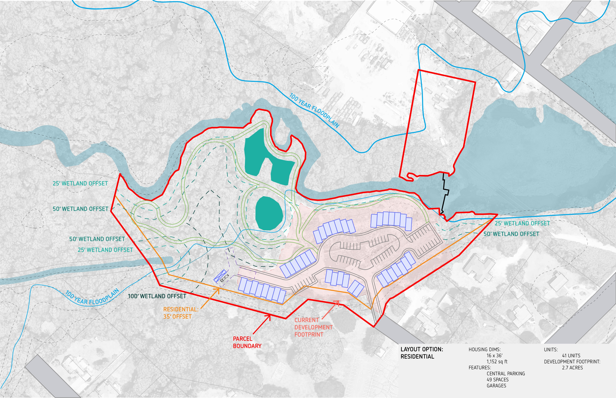
Concept Plan: Residential Scenario
Residential: 41 units (1,150 -1,450 sf)
Building height: 2.5 stories
Parking: 49 spaces + 41 garages
Development footprint: 2.7 acres
Density = 5 units/ac across site; 15 units/acre on developable portion; developable portion = 33% of total site
Notes:
53,300 sf

Slide 18
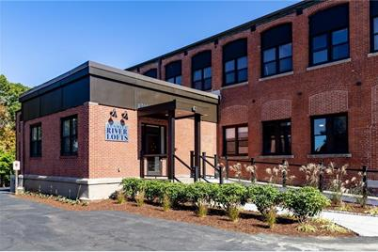
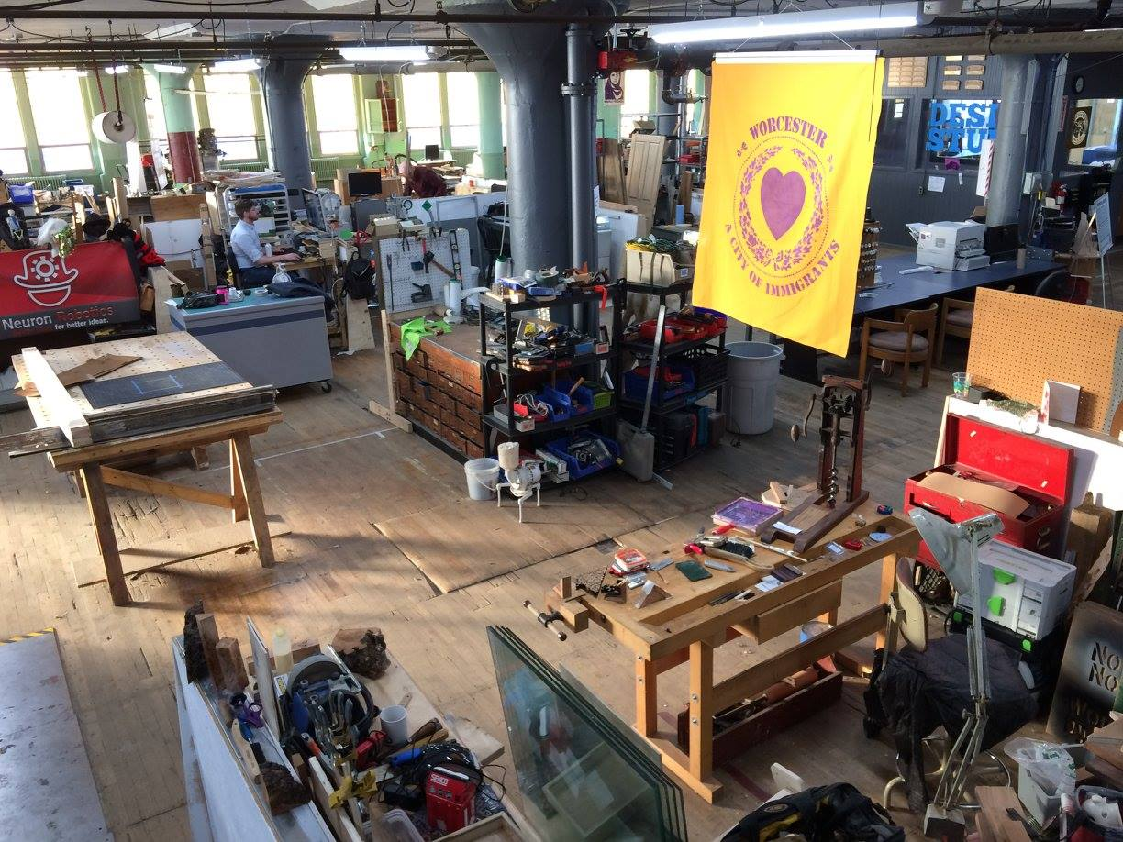
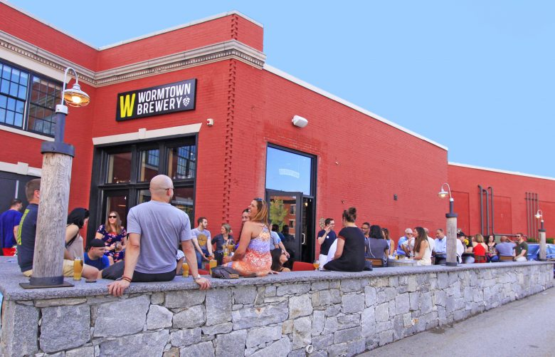
Development Potential: Mixed Use/loft
Mix of uses
Brewery, small manufacturing studios, maker spaces
Residential lofts spaces or life/workspaces
New construction
Ten Mile River Lofts, 1110 Central Ave, Pawtucket, RI 02861
Technocopia marketspace, Worcester
Wormtown Brewery, Worcester, MA
https://newengland.com/today/travel/massachusetts/guide-to-central-massachusetts-craft-breweries/; https://www.facebook.com/Technocopia/

Slide 19
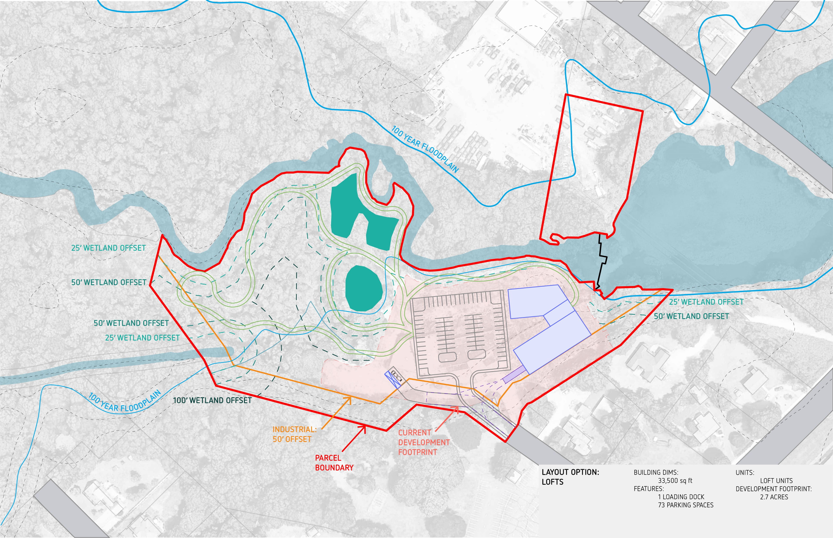
Concept Plan: Mixed Use/Loft Scenario
Floor area: 36,000 sf
Building height: 2 story
Parking: 73 spaces, 1 loading dock
Development footprint: 2.7 acres
FAR = 0.1 across site; 0.3 on developable portion; developable portion = 33% of total site

Slide 20
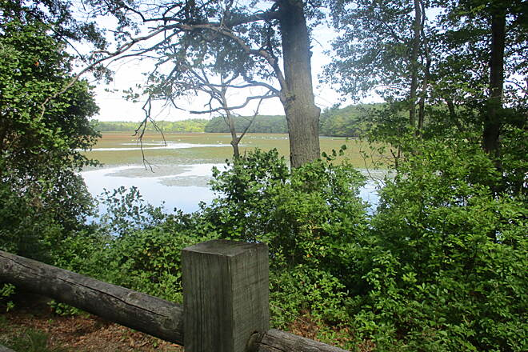
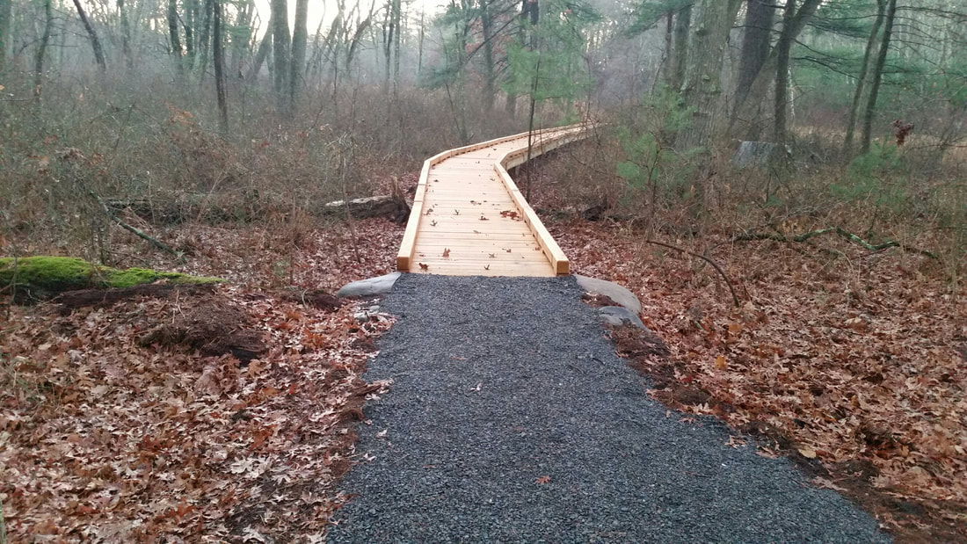
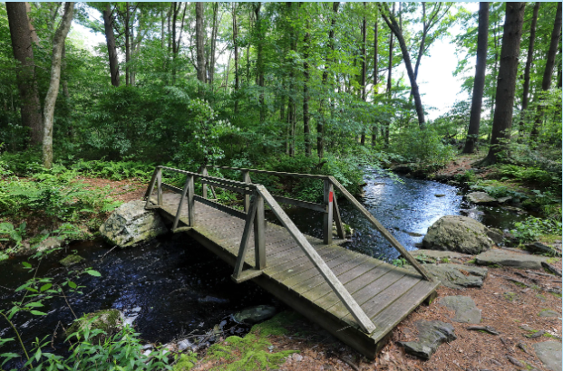
Amenities To Complement Development
Waterfront access for fishing, kayaking, and walking
Open space trails and natural habitat to serve new development and surrounding residential areas
Interpretive signage: history of site, natural environment of the river
Ten-Mile Greenway
Runnins River
Caratunk Wildlife Refuge
https://asri.org/hike/wildliferefuges/caratunk-wildlife-refuge.html; https://www.traillink.com/trail-gallery/ten-mile-river-greenway/

Slide 21
Decision Points in Redevelopment Process
Regulatory Changes
No Regulatory Changes
Industrial Use
Real Estate & Market Feasibility
Allow for Flexibility
(housing, mixed use, industrial)
Site Concept Studies
Establish Site Design Guidelines for RFP
Sewage Options
Additional Funding for Remediation and Building Demolition
Prepare and Issue Developer RFP

Slide 22
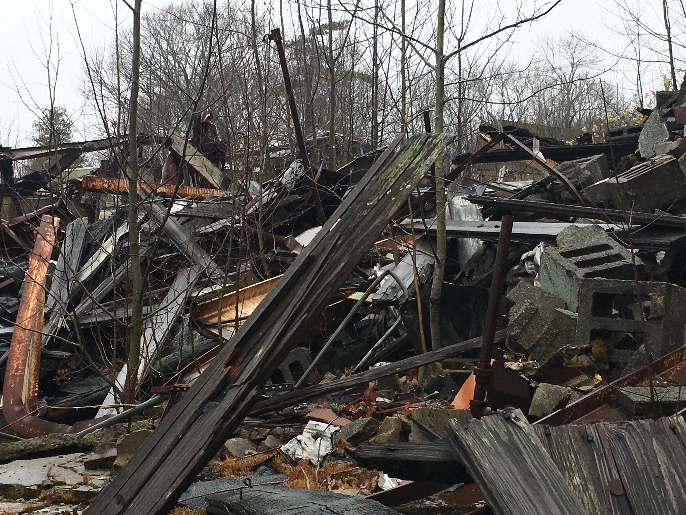
Implementation / Next Steps
Site Preparation (Years 1-3)
Draft current report as the basis for a developer RFP
Apply for EPA Regional Technical Assistance to advance market analysis and engage community further on goals and guidelines for site disposition RFP
Seek economic development funding for additional remediation and building demolition (MassDevelopment, others)
Determine sewage options (ongoing ES&M study)
Assess dam removal implications (ongoing GPI study)
Evaluate zoning options: industrial status quo; Chapter 40b; and/or updated multi-family overlay zone
Removal of the mill ruins and hazardous material remediation are critical paths for site readiness
EPA allows only one clean-up grant per site; already obtained

Slide 23
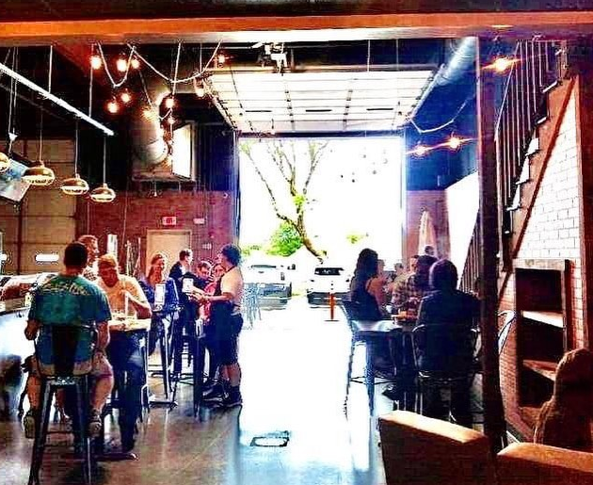
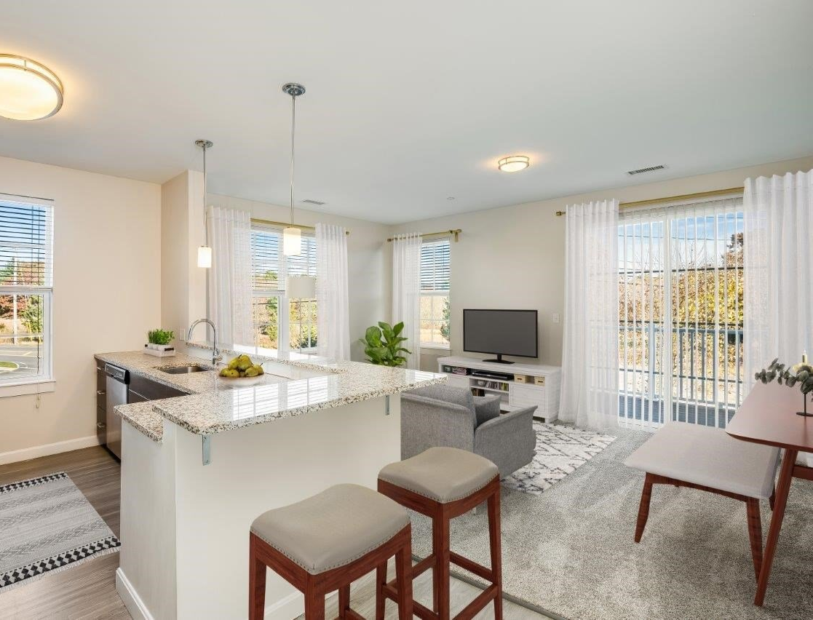
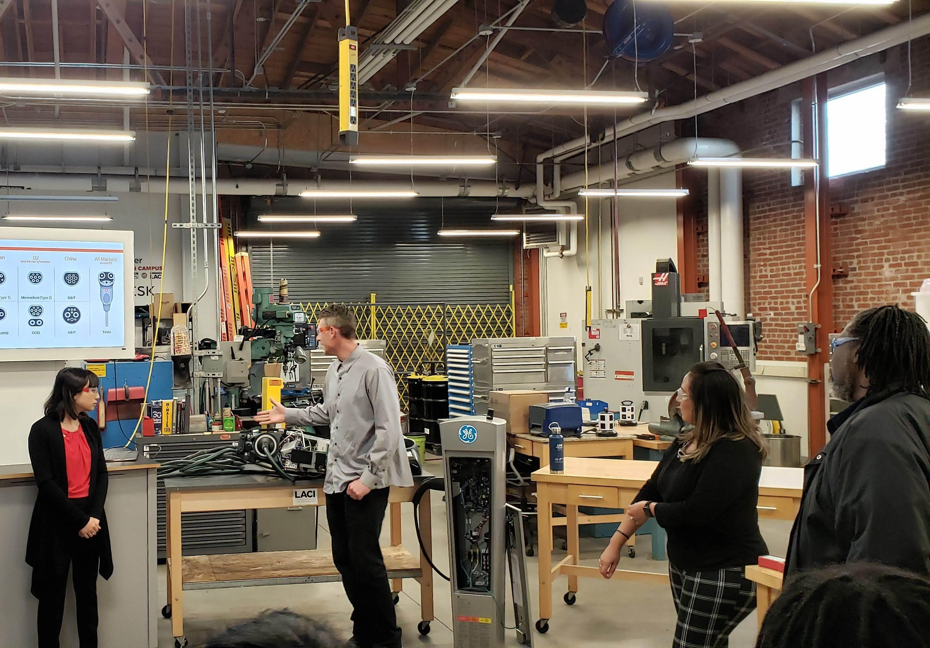
Implementation / Next Steps
Site Disposition (Years 4-5)
Follow State Chapter 30B and Town of Seekonk Surplus Property Disposition Policy #28 (1995)
Prepare developer Request for Proposal
Follow competitive bid process (Board of Selectmen)
Select most advantageous proposal and negotiate with developer (Board of Selectmen)
Dispose of property
Ten-Mile River
Brewery/mixed use
Residential dwelling units
Cleantech incubator/manufacturing
Notes:
https://bentlyfoundation.org/grants/los-angeles-cleantech-incubator;
https://www.rentcafe.com/apartments-for-rent/us/ma/attleboro/?DetailsPreview=728768
67 Degrees Brewery, Franklin, MA

